Slide 1
An introduction to graphical testing procedures for group-sequential designs
Michael Grayling Yevgen Tymofyeyev Senior Principal Statistician Senior Scientific Director
Statistical Modelling and Methodology Statistical Modelling and Methodology
Statistics & Decision Sciences Statistics & Decision Sciences
MCP-2025
1:00-4:30pm 12th Aug 2025
Center City campus, Temple University, Philadelphia, Pennsylvania, USA

Slide 2
Short Course
Online abstract
Multiple testing problems arise regularly in the design of clinical trials due to the presence of diverse sets of research hypotheses posed by multiple endpoints, treatment arms, subgroups, and combinations of these factors. Over the past decade, there has been a great expansion in the availability of methodology for performing sequential tests of multiple hypotheses. Amongst such methods, graphical testing in a group-sequential setting (see, e.g., Maurer and Bretz, 2013) has found particular utility, having now been leveraged in numerous studies. In this course, we will provide attendees with the necessary information to evaluate, select, and implement such a design in practice. This will include discussion of nuances related to planning the timing and triggering of interim analyses and comprehensive pragmatic detailing of analysis criteria.
A brief description of graphical testing in the fixed-sample setting and group-sequential design for a single hypothesis will be provided, alongside a recap of how to implement these approaches in R, however some familiarity with these methods will be helpful. The primary focus of the course will then be on how to identify and implement the stopping rules of a group-sequential trial under a graphical testing procedure, describing the minimal information that must be specified for a design to be determined. Key options within this methodology will then be covered, including the utility of ‘look back’ analyses, how one can modify the alpha spending function for a hypothesis on updating the graph, and different alternatives for triggering interim analyses. We discuss both purely statistical and real-world considerations when selecting a design, and also detail how simulation can be used to estimate key marginal power quantities accounting for the correlation between all test statistics.
To help implement such approaches in practice, we also discuss a Quarto template that leverages the popular {gsDesign} and {gMCP} to dynamically and efficiently produce a design and its operating characteristics in a form directly useable with a protocol, for arbitrarily complex multiple hypothesis testing and interim analysis strategies. Throughout the course, we use several recent trials (e.g., Burtness et al (2019) from the KEYTRUDA program) as elucidating examples, to cover use cases with multiple arms, multiple endpoints, and multiple populations.
Brutness B, et al. Pembrolizumab alone or with chemotherapy versus cetuximab with chemotherapy for recurrent or metastatic squamous cell carcinoma of the head and neck (KEYNOTE-048): A randomised, open-label, phase 3 study. Lancet 2019;394:1915-28.
Maurer W, Bretz F. Multiple testing in group sequential trials using graphical approaches. Stat Biopharm Res 2013;5:311-20.

Slide 3


Short Course
Instructors
Dr. Michael Grayling is a Senior Principal Statistician within the Statistical Modelling and Methodology group at Johnson & Johnson, primarily supporting issues in Oncology and Immunology. Before joining J&J, Michael worked as a Research Fellow in Biostatistics at Newcastle University, where he developed a significant level of teaching experience and mentored multiple graduate students. His research interests include multi-arm multi-stage trials, crossover studies, and small sample sizes. He has published more than 50 papers in peer-reviewers journals and has authored a number of R packages and Stata modules related to trial design. Having a long record of teaching similar courses and delivering invited presentations focusing on adaptive design and multiple testing procures, including running a two-day course on this topic in five countries, attendees will in particular benefit from Michael’s well-developed materials and presentation experience on the subject matter.
Dr. Yevgen Tymofyeyev is a Senior Scientific Director in the Statistical Modelling and Methodology group at Johnson & Johnson. In his current role, he serves as the statistical modelling lead for the Oncology Therapeutic area, implementing innovative designs and methods, including programs that utilize complex multi-stage designs with multiple hypothesis testing objectives, which have resulted in the successful submission of several clinical trials. He is actively involved in scientific collaborations in the field of randomization, adaptive design methodology, and software, which have led to an extensive list of publications, presentations, and implementation tools. Having 20 years of experience in pharmaceutical development, attendees will in particular benefit from Yevgen’s extensive expertise in employing complex methods in practice.

Slide 4
Short Course
Outline
10 mins: Initial setup and intro to examples Michael Grayling
25 mins: Refresher on group-sequential design for a single hypothesis Yevgen Tymofyeyev
Information fractions
Canonical joint distribution
Error spending
25 mins: Refresher on graphical testing procedures in fixed sample designs Michael Grayling
As a special case of closed testing
‘Epsilon’ edges
Power calculation
10 mins: Break
30 mins: Short practical on group-sequential design / graphical testing using R Michael Grayling / Yevgen Tymofyeyev
Using {gsDesign}/{rpact} and {gMCP}/{graphicalMCP} to reproduce study design(s)
45 mins: Graphical testing in group-sequential designs Yevgen Tymofyeyev
Spending function updating (i.e., ‘delayed’ alpha recycling)
‘Look back’ analyses
Analysis triggers (including in multi-arm event driven studies)
Simulation accounting for all correlations
10 mins: Break
45 mins: Software demonstration and practical Michael Grayling
Demonstration of the functionality of a dynamic R Markdown template
Practical on using this template to reproduce recent study design(s)
10 mins: Q&A and Close Michael Grayling / Yevgen Tymofyeyev
Opportunity to ask questions, from theoretical issues to implementation problems

Slide 5
Software installation
Run short_course_gtp_gsd_install_required_packages.R
To make the practical sessions run as smoothly as possible, we’ve created a short R script that installs the required packages
Minimally, you will need {appendMCP} to install
{graphicalMCP} and {rpact} may also be used in parts

Slide 6

Running example 1: KEYNOTE-598
See /Examples/Running example 1 - KEYNOTE-598/
Pembro-mono standard 1L therapy for mNSCLC with PD-L1 TPS ≥ 50% without actionable driver mutations
KEYNOTE-598 investigated whether addition of ipilimumab to pembro-mono improves efficacy
See Boyer et al. (2021) for the primary results, where the protocol is also available
For further information, see NCT03302234

Slide 7
Running example 1: KEYNOTE-598
Sample size and endpoints
1:1 randomization of N = 568 pts over 20 mo
Dual primary endpoints: OS and PFS
One key secondary endpoint also included in the graphical testing procedure: ORR
OS:
Analysis method: (Stratified) log-rank
Control arm: Exponential with a median of 20 mo
Treatment arm: HR = 0.70
Drop-out: 1% per year
PFS:
Analysis method: (Stratified) log-rank
Control arm: Piece-wise exponential with a median of 6.5 mo before 6.5 mo and a median of 14.5 mo after 6.5 mo
Treatment arm: HR = 0.69
Drop-out: 13% per year
ORR:
Analysis method: (Stratified) Miettinen and Nurminen
Control arm: 39%
Treatment arm: Δ = 20%

Slide 8
Running example 1: KEYNOTE-598
Interim analysis and multiplicity plan
Two efficacy IAs and one FA
Lan-DeMets O’Brien-Fleming spending functions for OS and PFS
ORR matures at time of IA1
Family-wise error rate for OS, PFS, and ORR controlled in the strong sense to one-sided α = 0.025
Analysis | Trigger | Primary purpose
IA1 | ~255 OS events | Interim PFS (~92%IF) and OS analyses (~71%IF)
IA2 | ~307 OS events | Final PFS analysis and interim OS analysis (~85%IF)
FA | ~361 OS events | Final OS analysis
OS
α = 0.019
PFS α = 0.006
0.999
0.999
1
0.001
0.001
ORR α = 0

Slide 9
Running example 1: KEYNOTE-598
Efficacy boundaries and properties for PFS analyses: Table 18 in Section 8.8.2
Analysis | Value | α = 0.006 | α = 0.025
IA1: 92%ª N: 568 Events: 357 Month: ~ 32^{f} | Z | 2.6394 | 2.0667
 | p (1-sided)^{b} | 0.0042 | 0.0194
 | HR at bound^{c} | 0.7562 | 0.8034
 | P(Cross) if HR=1^{d} | 0.0042 | 0.0194
 | P(Cross) if HR=0.69e | 0.8085 | 0.9251
IA2: Final PFS Analysis N: 568 Events: 389 Month: ~ 39^{f} | Z | 2.5869 | 2.0575
 | p (1-sided)^{b} | 0.0048 | 0.0198
 | HR at bound^{c} | 0.7690 | 0.8115
 | P(Cross) if HR=1^{d} | 0.0060 | 0.0250
 | P(Cross) if HR=0.69e | 0.8692 | 0.9517
ª Percentage of total planned events at each interim analysis ^{b} The nominal α for testing ^{c} The approximate HR required to reach an efficacy bound ^{d} The probability of crossing a bound under the null hypothesis ^{e} The probability of crossing a bound under the alternative hypothesis ^{f} The approximate number of months since first subject randomized

Slide 10
Running example 1: KEYNOTE-598
Efficacy boundaries and properties for OS analyses: Table 19 in Section 8.8.3
Analysis | Value | α = 0.019 | α = 0.025
IA1: 71%ª N: 568 Events: 255 Month: ~ 32^{f} | Z | 2.5592 | 2.4257
 | p (1-sided)^{b} | 0.0052 | 0.0076
 | HR at bound^{c} | 0.7256 | 0.7378
 | P(Cross) if HR=1^{d} | 0.0052 | 0.0076
 | P(Cross) if HR=0.7e | 0.6135 | 0.6631
IA2: 85% N: 568 Events: 307 Month: ~ 39^{f} | Z | 2.3490 | 2.2316
 | p (1-sided)^{b} | 0.0094 | 0.0128
 | HR at bound^{c} | 0.7646 | 0.7750
 | P(Cross) if HR=1^{d} | 0.0110 | 0.0151
 | P(Cross) if HR=0.7e | 0.7900 | 0.8228
FA^{g}: N: 568 Events: 361 Month: ~ 47^{f} | Z | 2.1577 | 2.0504
 | p (1-sided)^{b} | 0.0155 | 0.0202
 | HR at bound^{c} | 0.7967 | 0.8058
 | P(Cross) if HR=1^{d} | 0.0190 | 0.0250
 | P(Cross) if HR=0.7e | 0.8985 | 0.9167
ª Percentage of total planned events at each interim analysis ^{b} The nominal α for testing ^{c} The approximate HR required to reach an efficacy bound ^{d} The probability of crossing a bound under the null hypothesis ^{e} The probability of crossing a bound under the alternative hypothesis ^{f} The approximate number of months since first subject randomized ^{g} FA will be conducted at 34 months after the enrollment of the last participant at the latest, if the event accumulation is slower than expected

Slide 11
Running example 1: KEYNOTE-598
Efficacy boundaries and properties for ORR analyses: Section 8.8.1
“No initial alpha is allocated to test ORR. However, the ORR p-value from IA1 (ie, no new data is added after IA1) can be compared to an α-level of eg, 0.025 if the null hypotheses for both PFS and OS are rejected at IA1 or a later time. The power at the updated α-level of 0.025 is 99.8%, with an approximate treatment difference (ΔORR) required for reaching the efficacy bound being 8.1%, assuming underlying 39% and 59% ORR in the control and experimental groups, respectively.”

Slide 12
Running example 2
See /Examples/Running example 2/
Ph3 oncology trial, comparing CON vs TRT
Enrollment
N = 450 pts, randomized 1:1
10 pts/mo for months 1-2; 15 pts/mo for months 3-4; 25 pts/mo thereafter
Four endpoints for which strong control to one-sided α = 0.025 is ensured
ORR and PFS as dual primary endpoints
CR and OS as key secondary endpoints
Three efficacy IAs and one FA
Lan-DeMets O’Brien-Fleming spending for PFS, Kim-DeMets-2 spending for OS
Analysis | Trigger | Primary purpose
IA1 | 6 mo after LPR | Final ORR analysis
IA2 | ~254 PFS events | Final PFS analysis
IA3 | ~211 OS events | Interim OS analysis
FA | ~243 OS events | Final OS analysis

Slide 13
Running example 2
See /Examples/Running example 2/
PFS
Analysis method: Log-rank
Control arm: Exponential with a median of 15 mo
Treatment arm: HR = 0.66
Drop-out: 5% per year
ORR
Analysis method: Pooled comparison of proportions
Control arm: 50%
Treatment arm: Δ = 20%
CR
Analysis method: Pooled comparison of proportions
Control arm: 30%
Treatment arm: Δ = 20%
OS
Analysis method: Log-rank
Control arm: Exponential with a median of 27 mo
Treatment arm: HR = 0.69
Drop-out: 2% per year
PFS
α = 0.0225
ORR α = 0.0025
1
1
1
1
OS α = 0
CR α = 0

Slide 14
2. Refresher on group-sequential design for a single endpoint
Stopping rules
Information fractions
Choice of spending function, including nominal spending
(Futility stopping)
{gsDesign} and {rpact}
25 mins

Slide 15
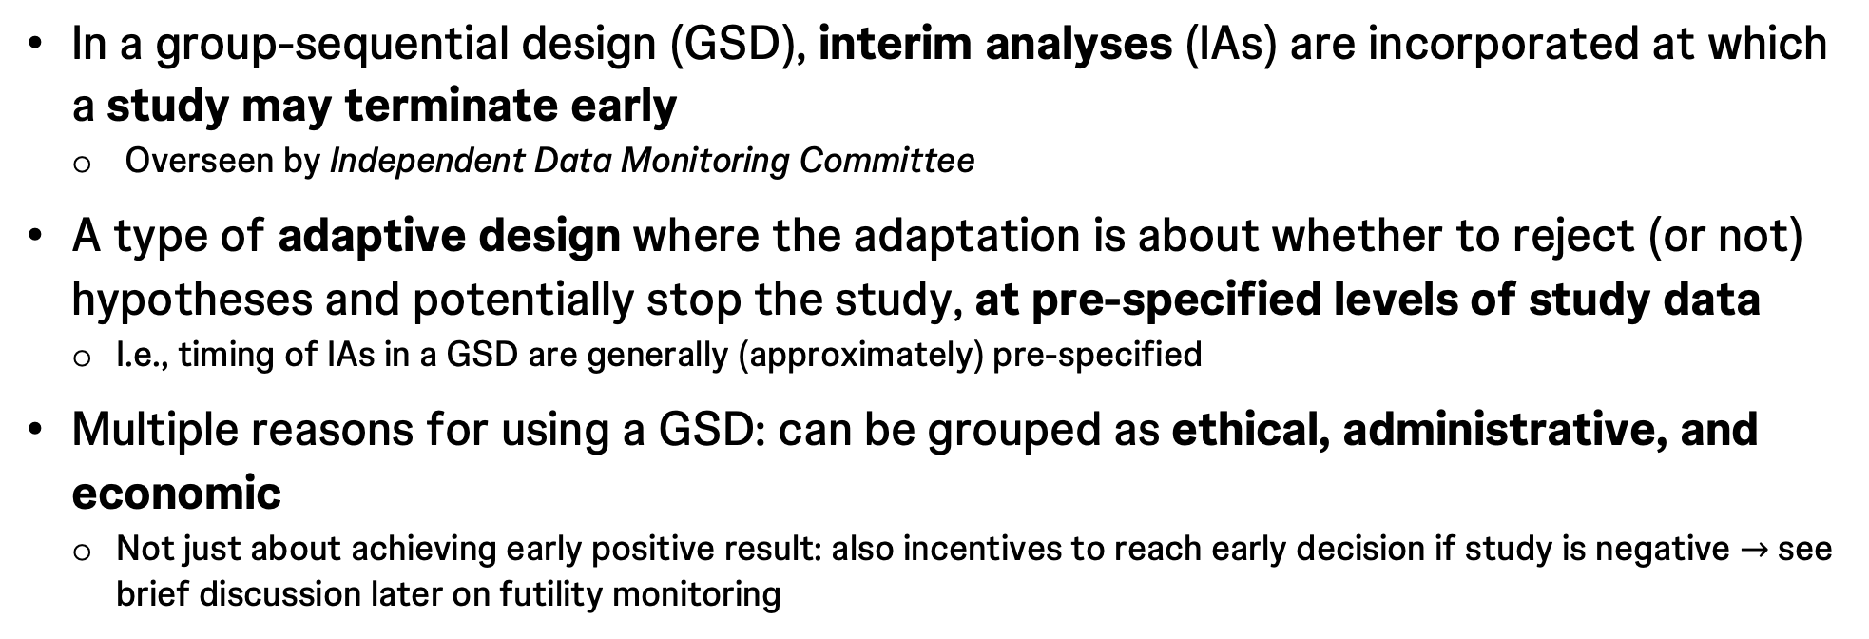
Introduction to group-sequential design
What, why, and how?
In a group-sequential design (GSD), interim analyses (IAs) are incorporated at which a study may terminate early
Overseen by Independent Data Monitoring Committee
A type of adaptive design where the adaptation is about whether to reject (or not) hypotheses and potentially stop the study, at pre-specified levels of study data
I.e., timing of IAs in a GSD are generally (approximately) pre-specified
Multiple reasons for using a GSD: can be grouped as ethical, administrative, and economic
Not just about achieving early positive result: also incentives to reach early decision if study is negative $→$ see brief discussion later on futility monitoring
Notes:
Ethical considerations are dictated by the need to monitor results to ensure that patients are not exposed to unsafe or ineffective treatments. Administrative analysis is used to adjust study conduct and design. Economical reasons aim to achieve the best allocation of limited resources in drug development.

Slide 16
Introduction to group-sequential design
What, why, and how?
Over-arching idea is that in many trials its likely an early decision can be made about hypotheses
I.e., without the maximal amount of planned data
GSD can therefore reduce the expected sample size (ESS) and expected study duration (ESD)
Repeated testing of hypotheses will inflate the study-wide type I and/or type II error rate unless care is taken in the approach to assessing significance
Extensive literature on how to choose testing rules to control error rates to the desired level

Slide 17
Introduction to group-sequential design
What, why, and how?
Long history: Original theory dates back to Wald in the 1940s, with early medical applications by Armitage in the 1950/60s
Most commonly known methodology (Pocock / O’Brien-Fleming / Kim-DeMets) developed in 1970/80s
Error spending approach by Lan and DeMets (1983)
Now (probably) the most commonly utilized type of adaptive design
Still an active area of research
Multiple endpoints
Multiple arms
Majority of literature assumes a single endpoint of interest

Slide 18
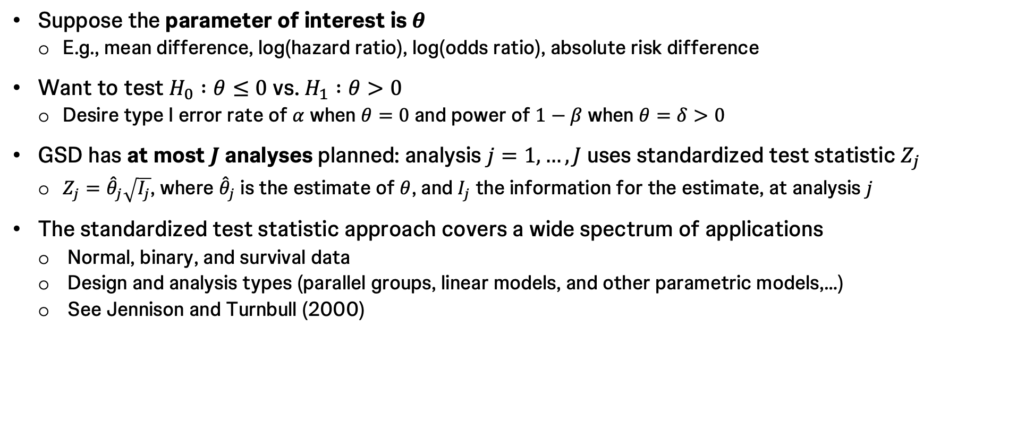
Test decisions using the Z-scale
Suppose the parameter of interest is $θ$
E.g., mean difference, log(hazard ratio), log(odds ratio), absolute risk difference
Want to test $H_{0} :θ≤0$ vs. $H_{1} :θ>0$
Desire type I error rate of $α$ when $θ=0$ and power of $1−β$ when $θ=δ>0$
GSD has at most $J$ analyses planned: analysis $j=1,…,J$ uses standardized test statistic $Z_{j}$
$Z_{j}={\hat{θ}}_{j}\sqrt{I_{j}}$, where ${\hat{θ}}_{j}$ is the estimate of $θ$, and $I_{j}$ the information for the estimate, at analysis $j$
The standardized test statistic approach covers a wide spectrum of applications
Normal, binary, and survival data
Design and analysis types (parallel groups, linear models, and other parametric models,…)
See Jennison and Turnbull (2000)

Slide 19
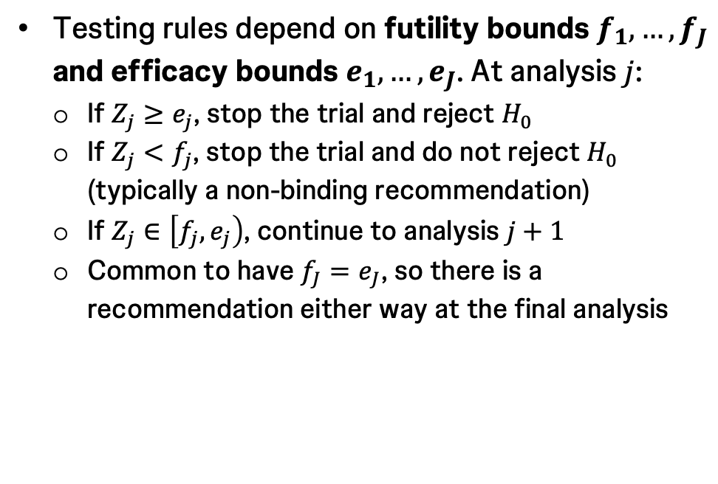
Stopping rules
Example for $J=4$
Testing rules depend on futility bounds $f_{1},…,f_{J}$ and efficacy bounds $e_{1},…,e_{J}$. At analysis $j$:
If $Z_{j}≥e_{j}$, stop the trial and reject $H_{0}$
If $Z_{j}<f_{j}$, stop the trial and do not reject $H_{0}$ (typically a non-binding recommendation)
If $Z_{j}∈\left[f_{j},e_{j}\right)$, continue to analysis $j+1$
Common to have $f_{J}=e_{J}$, so there is a recommendation either way at the final analysis
Non-binding recommendation means the trial can continue

Slide 20
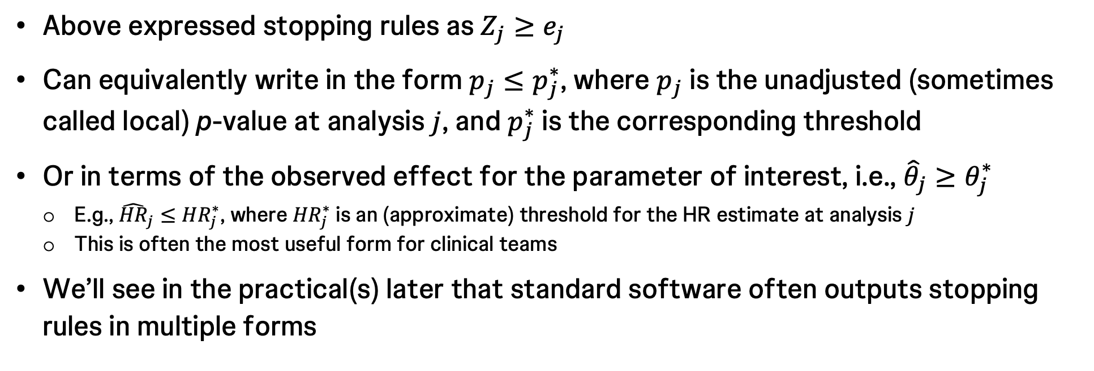
Other forms of stopping rules
p-value and effect scales
Above expressed stopping rules as $Z_{j}≥e_{j}$
Can equivalently write in the form $p_{j}≤p_{j}^{∗}$, where $p_{j}$ is the unadjusted (sometimes called local) p-value at analysis $j$, and $p_{j}^{∗}$ is the corresponding threshold
Or in terms of the observed effect for the parameter of interest, i.e., ${\hat{θ}}_{j}≥θ_{j}^{∗}$
E.g., ${\hat{HR}}_{j}≤{HR}_{j}^{∗}$, where ${HR}_{j}^{∗}$ is an (approximate) threshold for the HR estimate at analysis $j$
This is often the most useful form for clinical teams
We’ll see in the practical(s) later that standard software often outputs stopping rules in multiple forms

Slide 21
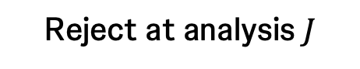
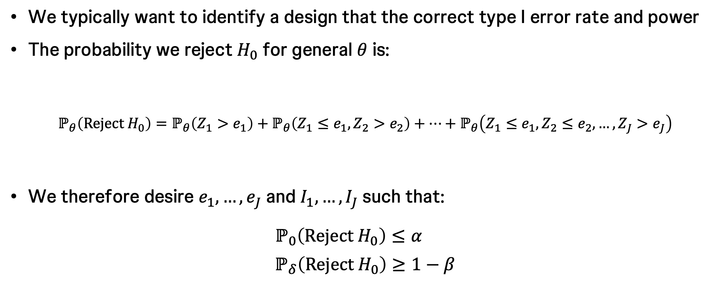
Error rate requirements
We typically want to identify a design that the correct type I error rate and power
The probability we reject $H_{0}$ for general $θ$ is:
$$ℙ_{θ}\left(Reject H_{0}\right)=ℙ_{θ}\left(Z_{1}>e_{1}\right)+ℙ_{θ}\left(Z_{1}≤e_{1},Z_{2}>e_{2}\right)+⋯+ℙ_{θ}\left(Z_{1}≤e_{1},Z_{2}≤e_{2},…,Z_{J}>e_{J}\right)$$
We therefore desire $e_{1},…,e_{J}$ and $I_{1},…,I_{J}$ such that:
$$ℙ_{0}\left(Reject H_{0}\right)≤α$$
$$ℙ_{δ}\left(Reject H_{0}\right)≥1−β$$
Reject at analysis 2
Reject at analysis 1
Reject at analysis $J$
Futility rules ignored when calculating type I error rate
Sometimes futility rules treated as binding when computing power; ignored here

Slide 22
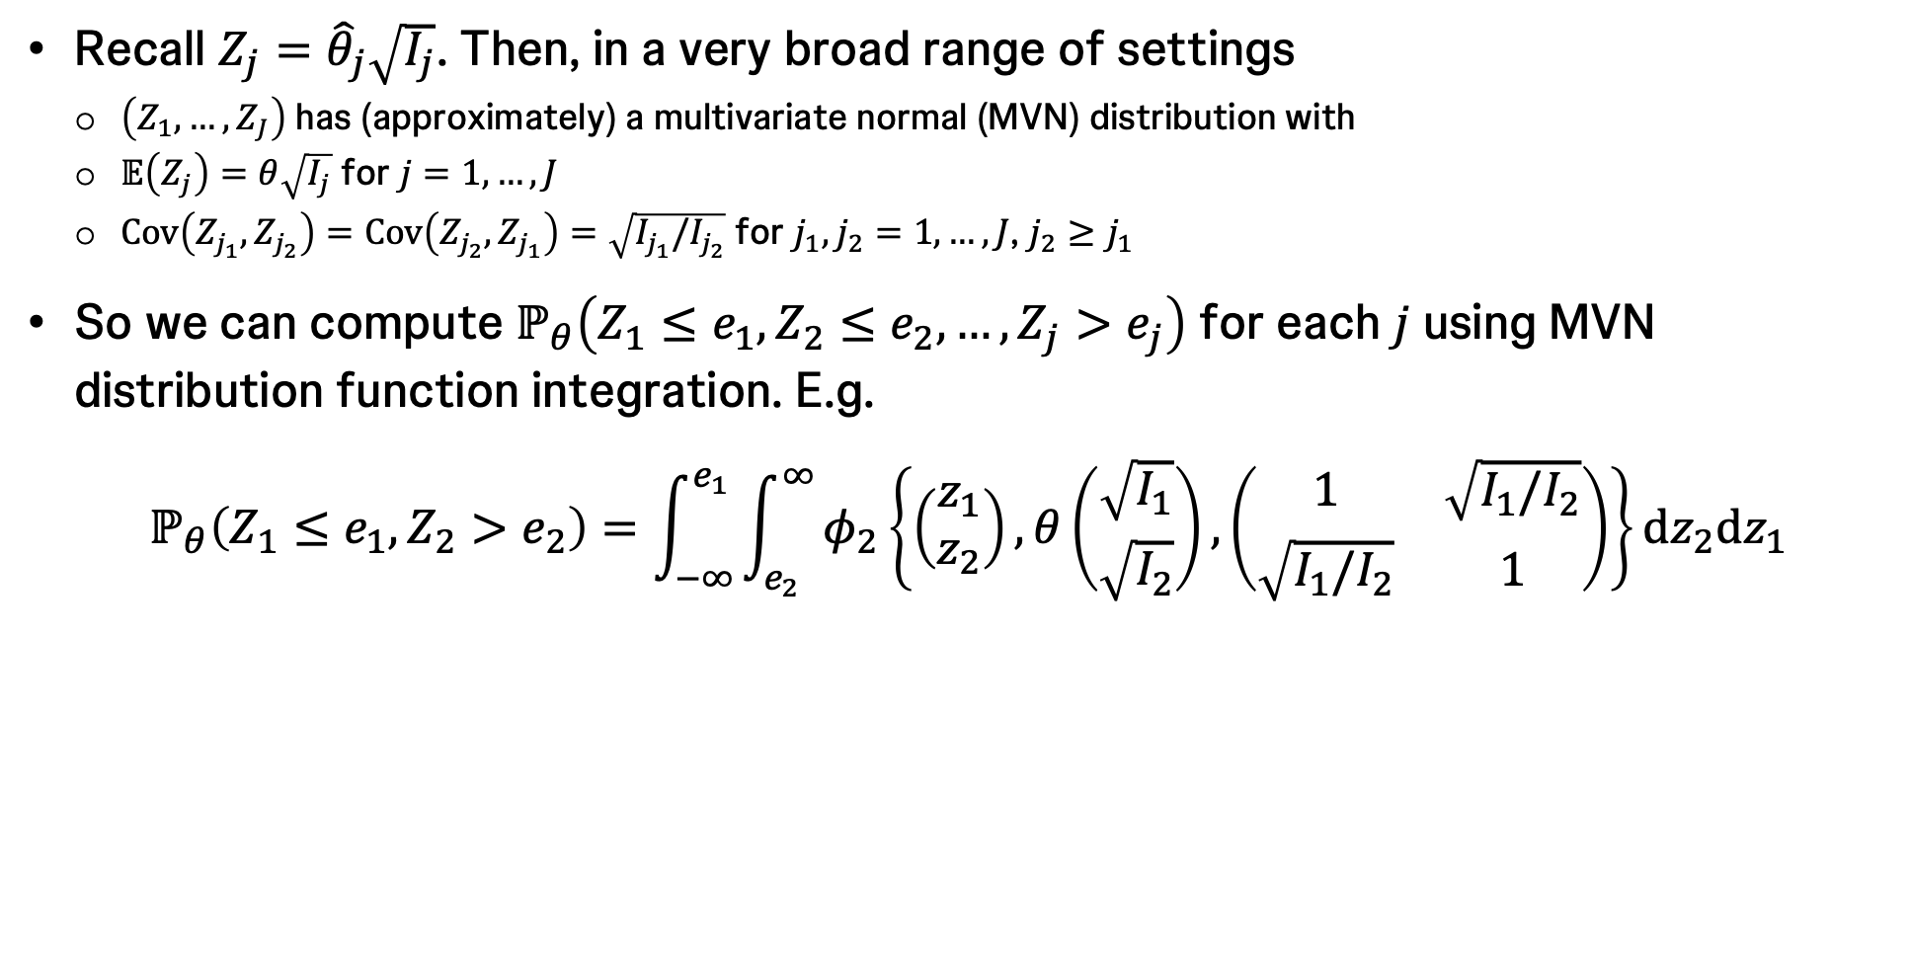
Computing error rates and other operating characteristics
The ‘canonical joint distribution’
Recall $Z_{j}={\hat{θ}}_{j}\sqrt{I_{j}}$. Then, in a very broad range of settings
$\left(Z_{1},…,Z_{J}\right)$ has (approximately) a multivariate normal (MVN) distribution with
$𝔼\left(Z_{j}\right)=θ\sqrt{I_{j}}$ for $j=1,…, J$
$Cov\left(Z_{j_{1}},Z_{j_{2}}\right)=Cov\left(Z_{j_{2}},Z_{j_{1}}\right)=\sqrt{I_{j_{1}}/I_{j_{2}}}$ for $j_{1},j_{2}=1,…,J$, $j_{2}≥j_{1}$
So we can compute $ℙ_{θ}\left(Z_{1}≤e_{1},Z_{2}≤e_{2},…,Z_{j}>e_{j}\right)$ for each $j$ using MVN distribution function integration. E.g.
$$ℙ_{θ}\left(Z_{1}≤e_{1},Z_{2}>e_{2}\right)=\int_{−∞}^{e_{1}}{\int_{e_{2}}^{∞}{φ_{2}\left\{\left(\begin{aligned}z_{1} \\ z_{2}\end{aligned}\right),θ\left(\begin{aligned}\sqrt{I_{1}} \\ \sqrt{I_{2}}\end{aligned}\right), \left(\begin{matrix}1 & \sqrt{I_{1}/I_{2}} \\ \sqrt{I_{1}/I_{2}} & 1\end{matrix}\right)\right\}}dz_{2}dz_{1}}$$

Slide 23
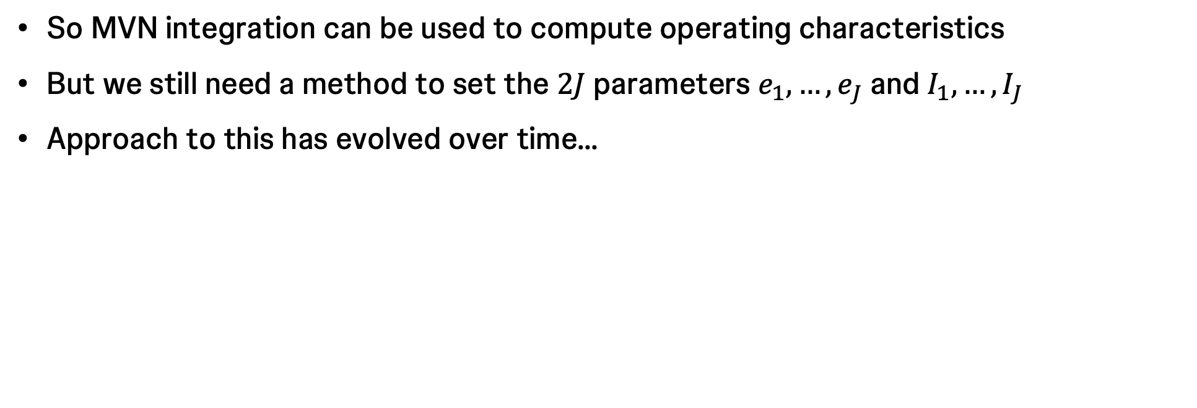
Computing a design
So MVN integration can be used to compute operating characteristics
But we still need a method to set the $2J$ parameters $e_{1},…,e_{J}$ and $I_{1},…,I_{J}$
Approach to this has evolved over time…

Slide 24
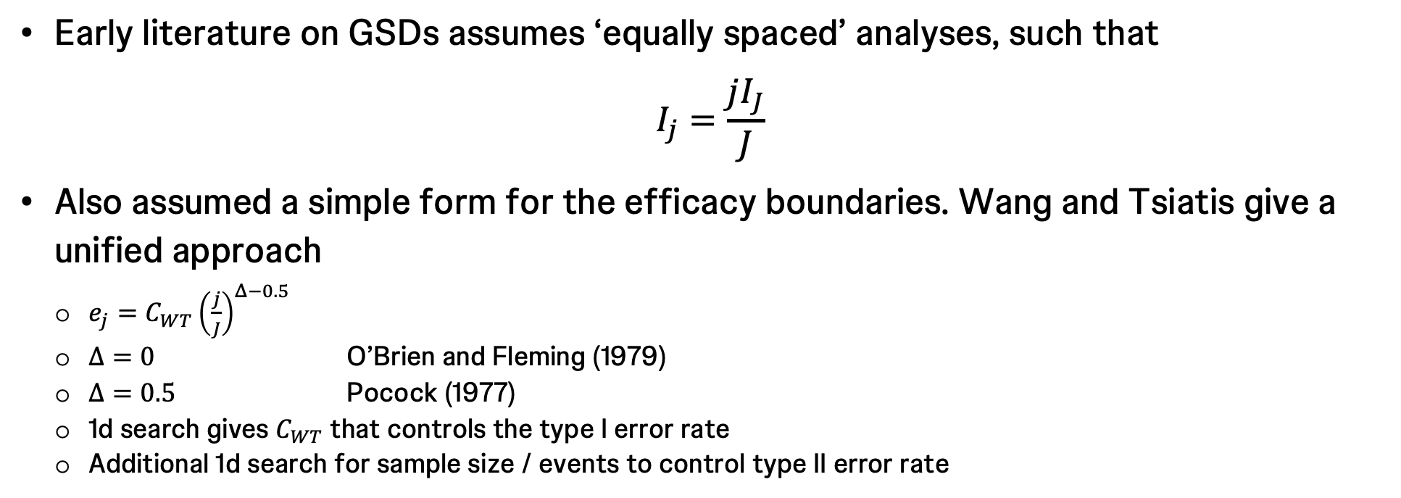
Functional form efficacy bounds
I.e., the original approach
Early literature on GSDs assumes ‘equally spaced’ analyses, such that
$$I_{j}=\frac{jI_{J}}{J}$$
Also assumed a simple form for the efficacy boundaries. Wang and Tsiatis give a unified approach
$e_{j}=C_{WT}{\left(\frac{j}{J}\right)}^{Δ−0.5}$
$Δ=0$ O’Brien and Fleming (1979)
$Δ=0.5$ Pocock (1977)
1d search gives $C_{WT}$ that controls the type I error rate
Additional 1d search for sample size / events to control type II error rate

Slide 25
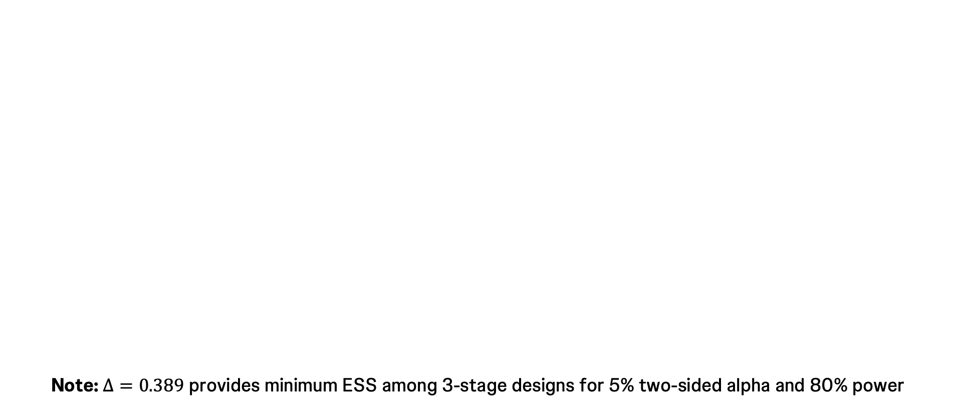
Functional form efficacy bounds
Wang and Tsiatis family with parameter Δ
O’Brien-Fleming boundaries required higher evidence of efficacy to terminate earlier in the trial
Note: $Δ=0.389$ provides minimum ESS among 3-stage designs for 5% two-sided alpha and 80% power
Pocock boundaries are constant across analyses

Slide 26
Functional form efficacy bounds
I.e., the original approach
Can easily be generalized for arbitrary information levels fixed in advance
Small deviation from the planned information levels will not lead to substantial impact on type I / II error rates
But a better way of designing under less-predictable information levels is…

Slide 27
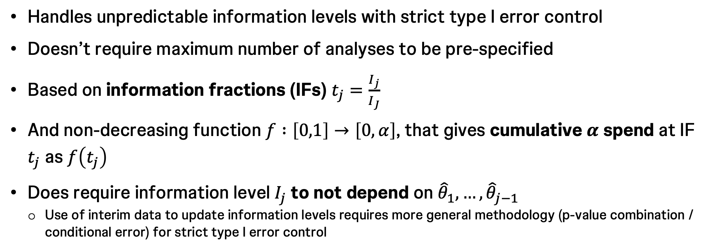
Error spending
I.e., the approach usually used today
Handles unpredictable information levels with strict type I error control
Doesn’t require maximum number of analyses to be pre-specified
Based on information fractions (IFs) $t_{j}=\frac{I_{j}}{I_{J}}$
And non-decreasing function $f :\left[0,1\right]→\left[0,α\right]$, that gives cumulative $α$ spend at IF $t_{j}$ as $f\left(t_{j}\right)$
Does require information level $I_{j}$ to not depend on ${\hat{θ}}_{1},…,{\hat{θ}}_{j−1}$
Use of interim data to update information levels requires more general methodology (p-value combination / conditional error) for strict type I error control

Slide 28
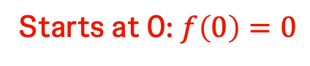
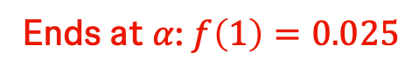
Running example 1: KEYNOTE-598
E.g., OS spending for $α=0.025$
Ends at $α$: $f\left(1\right)=0.025$
Three analyses
Spending functions always non-decreasing
Starts at 0: $f\left(0\right)=0$
28

Slide 29
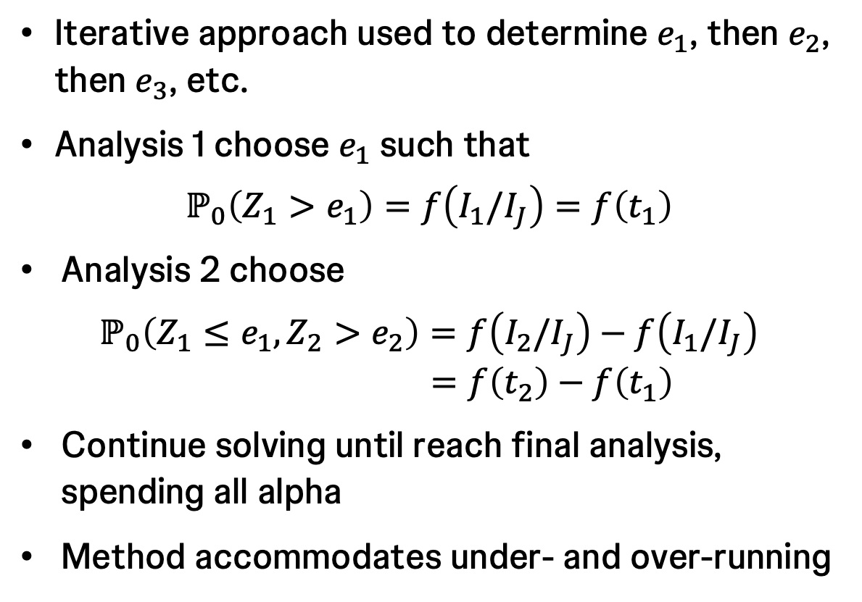
Error spending
Technical approach
Iterative approach used to determine $e_{1}$, then $e_{2}$, then $e_{3}$, etc.
Analysis 1 choose $e_{1}$ such that
$$ℙ_{0}\left(Z_{1}>e_{1}\right)=f\left(I_{1}/I_{J}\right)=f\left(t_{1}\right)$$
Analysis 2 choose
$$ℙ_{0}\left(Z_{1}≤e_{1},Z_{2}>e_{2}\right)=f\left(I_{2}/I_{J}\right)−f\left(I_{1}/I_{J}\right)$$
$$=f\left(t_{2}\right)−f\left(t_{1}\right)$$
Continue solving until reach final analysis, spending all alpha
Method accommodates under- and over-running

Slide 30
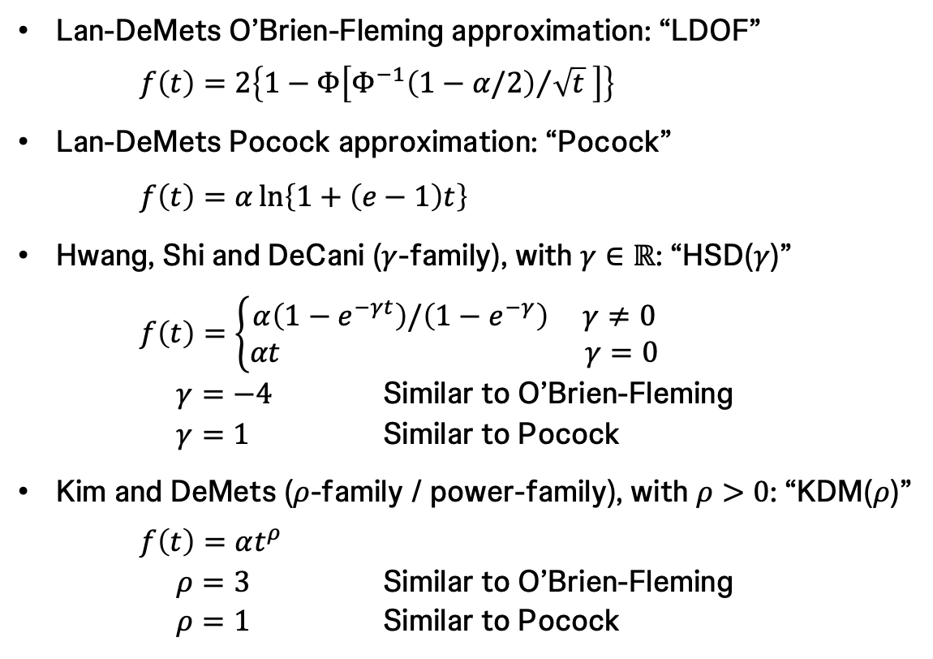
Common spending functions
Lan-DeMets O’Brien-Fleming approximation: “LDOF”
$f\left(t\right)=2\left\{1−Φ\left[{Φ^{−1}\left(1−α/2\right)}/{\sqrt{t} }\right]\right\}$
Lan-DeMets Pocock approximation: “Pocock”
$f\left(t\right)=α\ln\left\{1+\left(e−1\right)t\right\}$
Hwang, Shi and DeCani ($γ$-family), with $γ∈ℝ$: “HSD($γ$)”
$f\left(t\right)=\left\{\begin{aligned}α\left(1−e^{−γt}\right)/\left(1−e^{−γ}\right) γ≠0 \\ &αt γ=0\end{aligned}\right.$
$γ=−4$ Similar to O’Brien-Fleming
$γ=1$ Similar to Pocock
Kim and DeMets ($ρ$-family / power-family), with $ρ>0$: “KDM($ρ$)”
$f\left(t\right)=αt^{ρ}$
$ρ=3$ Similar to O’Brien-Fleming
$ρ=1$ Similar to Pocock
More aggressive spending
Less aggressive spending
30

Slide 31
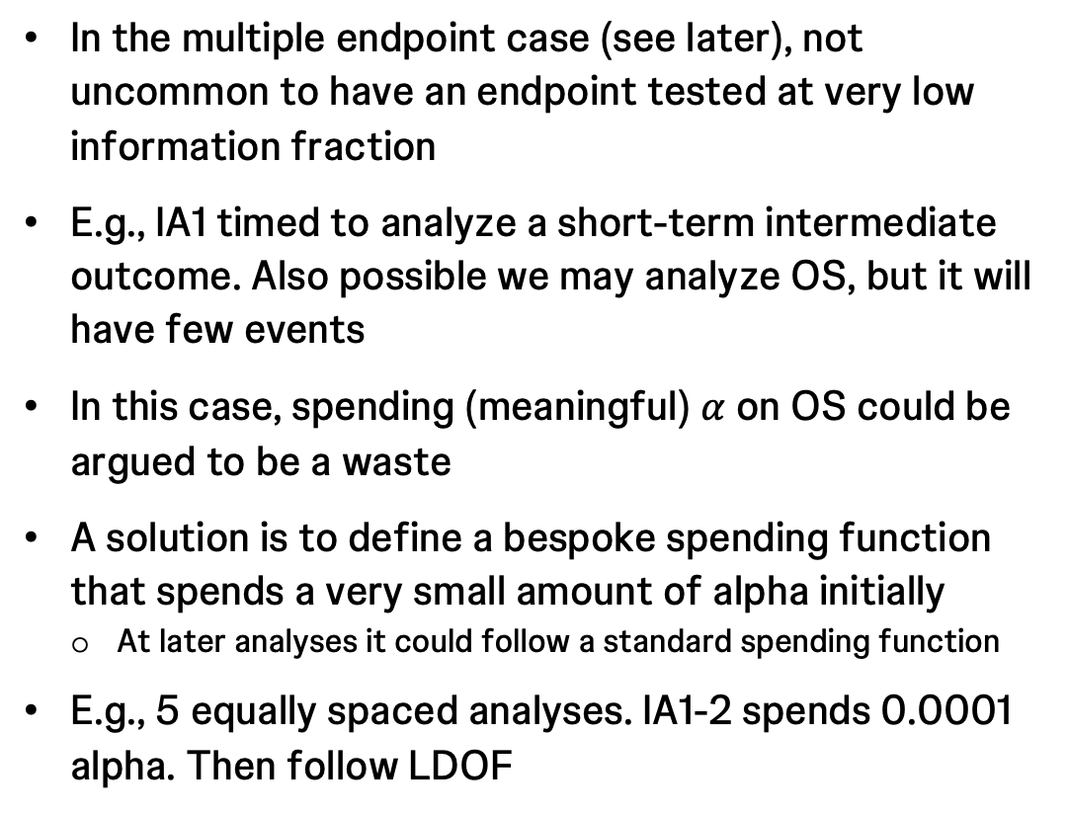
‘Nominal’ spending
In the multiple endpoint case (see later), not uncommon to have an endpoint tested at very low information fraction
E.g., IA1 timed to analyze a short-term intermediate outcome. Also possible we may analyze OS, but it will have few events
In this case, spending (meaningful) $α$ on OS could be argued to be a waste
A solution is to define a bespoke spending function that spends a very small amount of alpha initially
At later analyses it could follow a standard spending function
E.g., 5 equally spaced analyses. IA1-2 spends 0.0001 alpha. Then follow LDOF
Very small spend through IA2
31

Slide 32
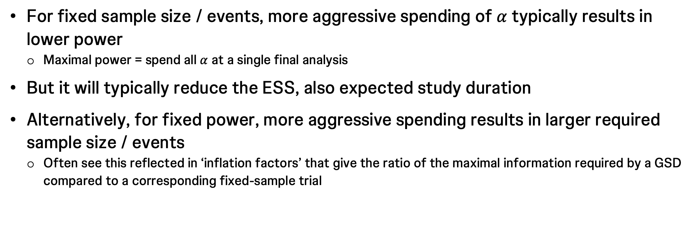
Spending options
Speed of spending trades reduction in expected sample size (ESS) or events for lower power
For fixed sample size / events, more aggressive spending of $α$ typically results in lower power
Maximal power = spend all $α$ at a single final analysis
But it will typically reduce the ESS, also expected study duration
Alternatively, for fixed power, more aggressive spending results in larger required sample size / events
Often see this reflected in ‘inflation factors’ that give the ratio of the maximal information required by a GSD compared to a corresponding fixed-sample trial

Slide 33
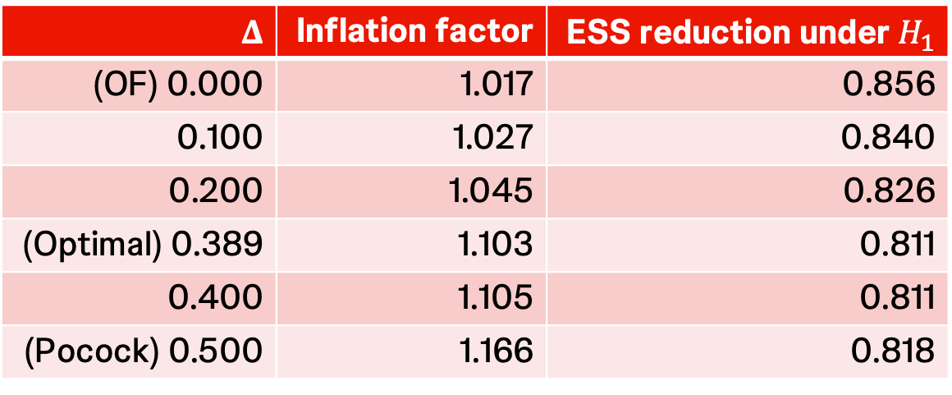
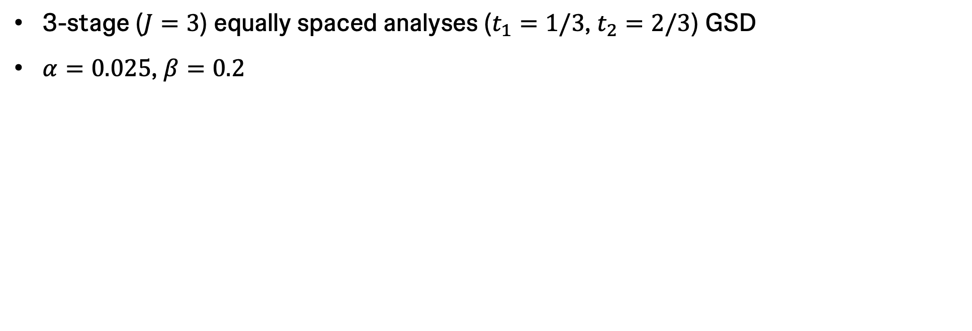

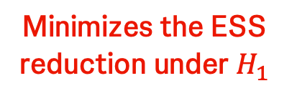
Spending options
Inflation factors and ESS reduction for Wang-Tsiatis bounds
3-stage ($J=3$) equally spaced analyses ($t_{1}=1/3$, $t_{2}=2/3$) GSD
$α=0.025$, $β=0.2$
$$Δ$$ | Inflation factor | ESS reduction under $H_{1}$
(OF) 0.000 | 1.017 | 0.856
0.100 | 1.027 | 0.840
0.200 | 1.045 | 0.826
(Optimal) 0.389 | 1.103 | 0.811
0.400 | 1.105 | 0.811
(Pocock) 0.500 | 1.166 | 0.818
Minimizes the ESS reduction under $H_{1}$
Increasing in $Δ$

Slide 34
Spending options
Inflation factors and ESS reduction for Wang-Tsiatis bounds
Further assume control arm mOS is 20 mo, and target HR is 0.7
As for OS in Running example 1: KEYNOTE-598
WT(0.389) is optimal for the 3-stage equal stage design with alpha=2.5%, power=80%
Power is 80%, when HR = 0.7
WT(0.389) is only minorly better than Pocock under this setting
Pocock and O’Brien-Fleming have opposite performance under extreme HRs

Slide 35
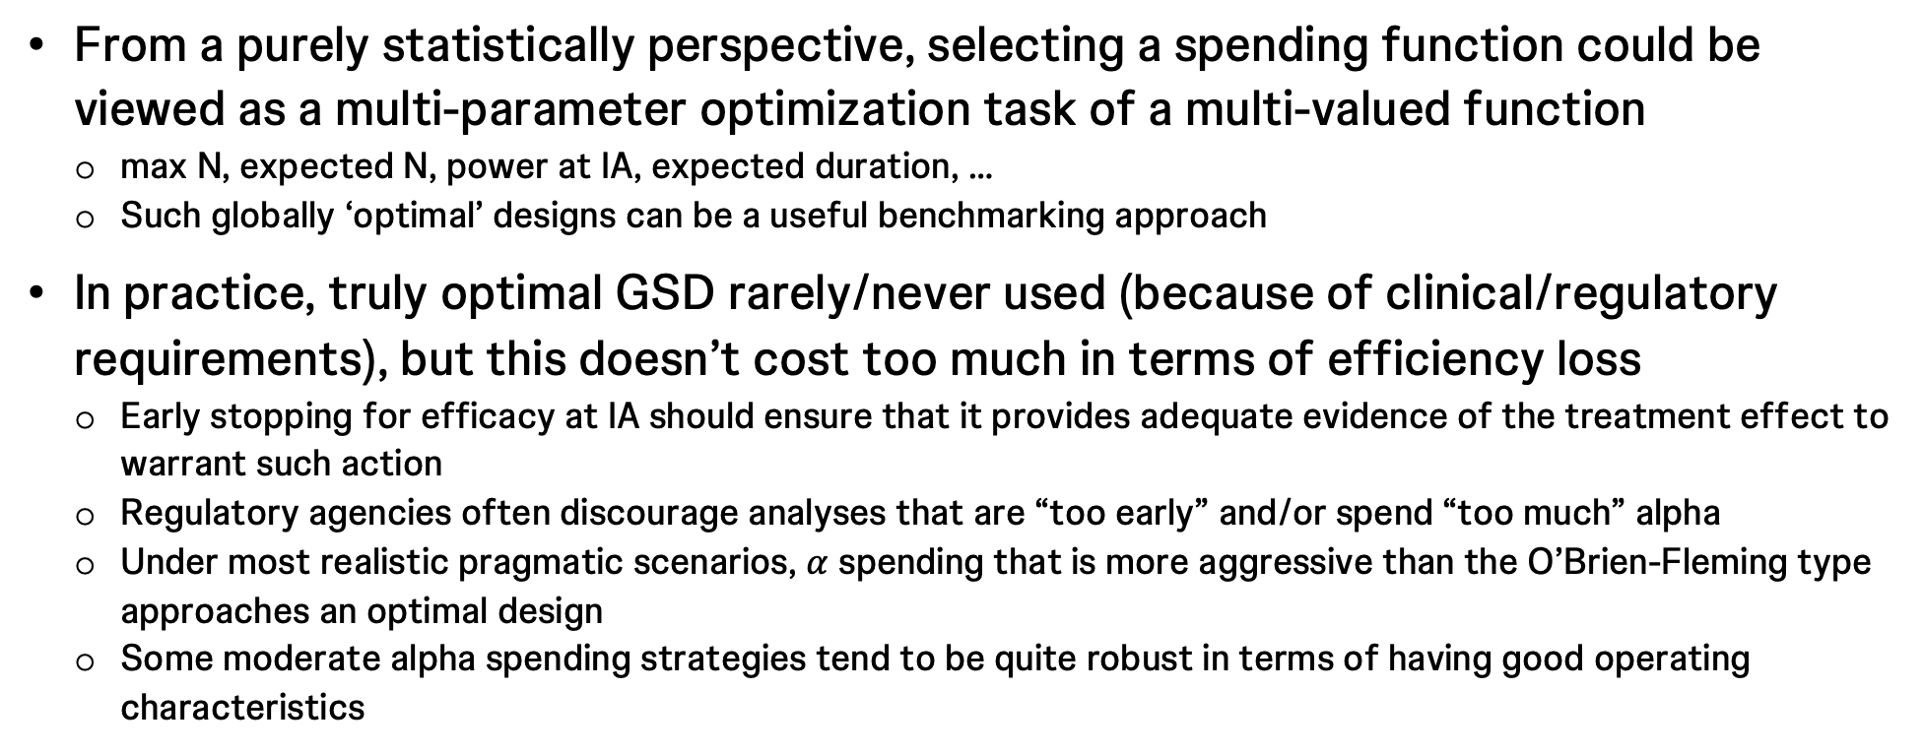
Spending options
Design considerations
From a purely statistically perspective, selecting a spending function could be viewed as a multi-parameter optimization task of a multi-valued function
max N, expected N, power at IA, expected duration, …
Such globally ‘optimal’ designs can be a useful benchmarking approach
In practice, truly optimal GSD rarely/never used (because of clinical/regulatory requirements), but this doesn’t cost too much in terms of efficiency loss
Early stopping for efficacy at IA should ensure that it provides adequate evidence of the treatment effect to warrant such action
Regulatory agencies often discourage analyses that are “too early” and/or spend “too much” alpha
Under most realistic pragmatic scenarios, $α$ spending that is more aggressive than the O’Brien-Fleming type approaches an optimal design
Some moderate alpha spending strategies tend to be quite robust in terms of having good operating characteristics

Slide 36
An aside on futility: Conventional futility monitoring
Why?
Can be very useful to build in futility assessment(s)
Based on context could be for one or more endpoints
Concession to regulatory authorities that generally costs very little
Set up the futility rule correctly and it is unlikely to be met unless the treatment is genuinely poor performing
Could save money and/or time
Dedicated IAs to futility and/or conduct when efficacy is assessed
In survival case, meaningful cost savings generally could only be associated with a futility look before recruitment has completed
~40%IF good benchmark for enough data for a futility look
Can be used for ruling out harm

Slide 37
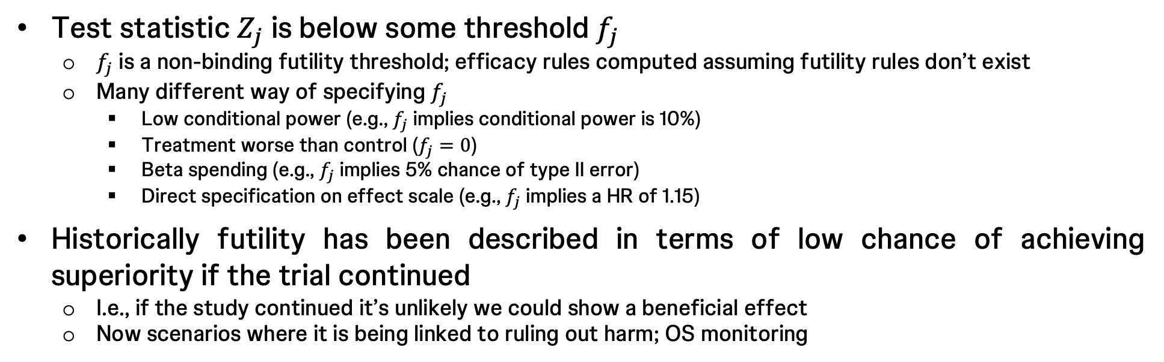
An aside on futility: Conventional futility monitoring
What? How?
Test statistic $Z_{j}$ is below some threshold $f_{j}$
$f_{j}$ is a non-binding futility threshold; efficacy rules computed assuming futility rules don’t exist
Many different way of specifying $f_{j}$
Low conditional power (e.g., $f_{j}$ implies conditional power is 10%)
Treatment worse than control ($f_{j}=0$)
Beta spending (e.g., $f_{j}$ implies 5% chance of type II error)
Direct specification on effect scale (e.g., $f_{j}$ implies a HR of 1.15)
Historically futility has been described in terms of low chance of achieving superiority if the trial continued
I.e., if the study continued it’s unlikely we could show a beneficial effect
Now scenarios where it is being linked to ruling out harm; OS monitoring

Slide 38


An aside on futility: Modern approach for OS
OS shifting more towards a safety endpoint: monitor for harm

Slide 39
Software
EAST
ADDPLAN
SAS SEQDESIGN
R
{gsDesign} https://gsdesign.shinyapps.io/prod/
{rpact} (~ADDPLAN) https://rpact.shinyapps.io/public/
Others too… https://cran.r-project.org/web/views/ClinicalTrials.html

Slide 40
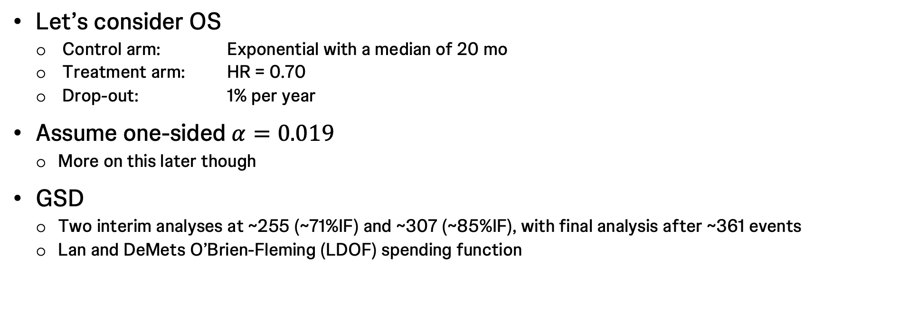
Running example 1: KEYNOTE-598
Let’s consider OS
Control arm: Exponential with a median of 20 mo
Treatment arm: HR = 0.70
Drop-out: 1% per year
Assume one-sided $α=0.019$
More on this later though
GSD
Two interim analyses at ~255 (~71%IF) and ~307 (~85%IF), with final analysis after ~361 events
Lan and DeMets O’Brien-Fleming (LDOF) spending function

Slide 41
Running example 1: KEYNOTE-598
gsDesign::gsSurv()
Input
gsDesign::gsSurv(k = 3,
test.type = 1,
alpha = 0.019,
beta = 0.1,
timing = c(0.71, 0.85, 1),
sfu = gsDesign::sfLDOF,
lambdaC = log(2)/20,
hr = 0.7,
eta = -log(1 - 0.01)/12,
gamma = 568/20,
R = 20,
minfup = NULL,
T = NULL)
Output
Time to event group sequential design with HR= 0.7
Equal randomization: ratio=1
One-sided group sequential design with
90 % power and 1.9 % Type I Error.
Analysis N Z Nominal p Spend
1 258 2.55 0.0054 0.0054
2 309 2.35 0.0094 0.0056
3 363 2.16 0.0155 0.0080
Total 0.0190
++ alpha spending:
Lan-DeMets O'Brien-Fleming approximation spending function (no parameters).
Boundary crossing probabilities and expected sample size
assume any cross stops the trial
Upper boundary (power or Type I Error)
Analysis
Theta 1 2 3 Total E{N}
0.0000 0.0054 0.0056 0.0080 0.019 361.5
0.1785 0.6226 0.1696 0.1078 0.900 287.7
T n Events HR efficacy
IA 1 31.41004 568 257.2980 0.728
IA 2 37.77820 568 308.0328 0.765
Final 46.33306 568 362.3915 0.797
Accrual rates:
Stratum 1
0-20 28.4
Control event rates (H1):
Stratum 1
0-Inf 0.03
Censoring rates:
Stratum 1
0-Inf 0

Slide 42
Running example 1: KEYNOTE-598
rpact::getSampleSizeSurvival()
Input
rpact::getSampleSizeSurvival(
design = rpact::getDesignGroupSequential(
kMax = 3,
alpha = 0.019,
beta = 0.1,
sided = 1,
informationRates = c(0.71, 0.85, 1),
typeOfDesign = "asOF"
),
lambda2 = log(2)/20,
hazardRatio = 0.7,
dropoutRate1 = 0.01,
dropoutRate2 = 0.01,
dropoutTime = 12,
accrualTime = c(0, 20),
accrualIntensity = 568/20
) |> summary()
Output
Sample size calculation for a survival endpoint
Sequential analysis with a maximum of 3 looks (group sequential design),
one-sided overall significance level 1.9%, power 90%.
The results were calculated for a two-sample logrank test,
H0: hazard ratio = 1, H1: hazard ratio = 0.7, control lambda(2) = 0.035,
accrual time = 20, accrual intensity = 28.4, dropout rate(1) = 0.01,
dropout rate(2) = 0.01, dropout time = 12.
Stage 1 2 3
Planned information rate 71% 85% 100%
Cumulative alpha spent 0.0054 0.0110 0.0190
Stage levels (one-sided) 0.0054 0.0094 0.0155
Efficacy boundary (z-value scale) 2.551 2.350 2.158
Efficacy boundary (t) 0.728 0.765 0.797
Cumulative power 0.6226 0.7922 0.9000
Number of subjects 568.0 568.0 568.0
Expected number of subjects under H1 568.0
Cumulative number of events 257.7 308.5 363.0
Expected number of events under H1 288.2
Analysis time 31.46 37.85 46.44
Expected study duration under H1 35.65
Exit probability for efficacy (under H0) 0.0054 0.0056
Exit probability for efficacy (under H1) 0.6226 0.1696
Legend:
(t): treatment effect scale

Slide 43
R package comparison
Cheatsheet on function arguments
 | {gsDesign} | {gsDesign2} | {rpact}
Computing required events for desired power | gsDesign::gsSurv() | gsDesign2::gs_design_ahr() | rpact::getSampleSizeSurvival()
Computing power for specified events | gsDesign::gsProbability() | gsDesign2::gs_power_ahr() | rpact::getPowerSurival()
Number of analyses | k | info_frac , event, and/or analysis_time Inferred by the package through one or more of these arguments | kMax, inside design design formatted through rpact::getDesignGroupSequential()
One-sided type I error-rate | alpha, with sided = 1 | alpha | alpha, with sided = 1, inside design design formatted through rpact::getDesignGroupSequential()
Desired power / type II error-rate | beta | beta | beta, inside design design formatted through rpact::getDesignGroupSequential()
Interim analysis timings (information fractions or events) | timing | info_frac , event, and/or analysis_time | informationRates, inside design, with maxNumberOfEvents for power design formatted through rpact::getDesignGroupSequential()
Alpha spending function and any associated parameters | sfu and sfupar | upar | typeOfDesign and gammaA, inside design design formatted through rpact::getDesignGroupSequential()
Control arm survival assumptions | lambdaC | fail_rate fail_rate formatted through gsDesign2::define_fail_rate() | median2 or lambda2
Treatment arm survival assumptions | hr |  | median1, lambda1, or hazardRatio
Dropout rate(s) | eta and etaE |  | dropoutRate1, dropoutRate2, and dropoutTime
Enrollment rate(s) over time | gamma, R, and ratio | enroll_rate and ratio enroll_rate formatted through gsDesign2::define_enroll_rate() | accrualTime, accrualIntensity, and accrualIntensityType

Slide 44
Summary
GSDs seek to reduce the expected sample size / time to a significant result
Easy to control type I error rate using error spending approach
On top of usual requirements for sample size calculation, specify:
IFs at the interim analyses
Spending function
Machinery now well established to support design
{gsDesign} and {rpact} in R cover most scenarios. See Practical 1 later

Slide 45
3. Refresher on graphical testing procedures in fixed sample designs
Basic multiplicity corrections
Introduction to graphical testing procedures
‘Epsilon’ edges
Partial correlation
25 mins
With thanks to David Robertson (MRC Biostatistics Unit, University of Cambridge)

Slide 46
Multiple testing procedures
Why?
Most clinical trials need to address the problem of multiple testing
We’ve already seen one reason this can arise: the presence of interim analyses
Also routinely happens because trials evaluate significance for multiple important outcomes
Some evaluate significance for multiple treatment arms
In any case, we then typically need to control the probability of committing one or more type I errors across the analyses
Family-wise error rate (FWER) control
Otherwise the probability of committing a type I error rises rapidly in the number of tests
(Whether FWER control is needed across multiple treatment arms can be a little more complex)
Multiple testing procedures are methods for achieving such FWER control

Slide 47
Multiple testing procedures
How?
Error-spending is a type of multiplicity correction that controls across multiple analyses
Here focus on corrections for the case of multiple hypotheses in a fixed-sample setting
Simple corrections (Bonferroni, Dunnett, …)
Many others we don’t discuss (Hochberg, Hommel, Šidák, …)
Closed testing procedures
Graphical testing procedures (GTPs)

Slide 48
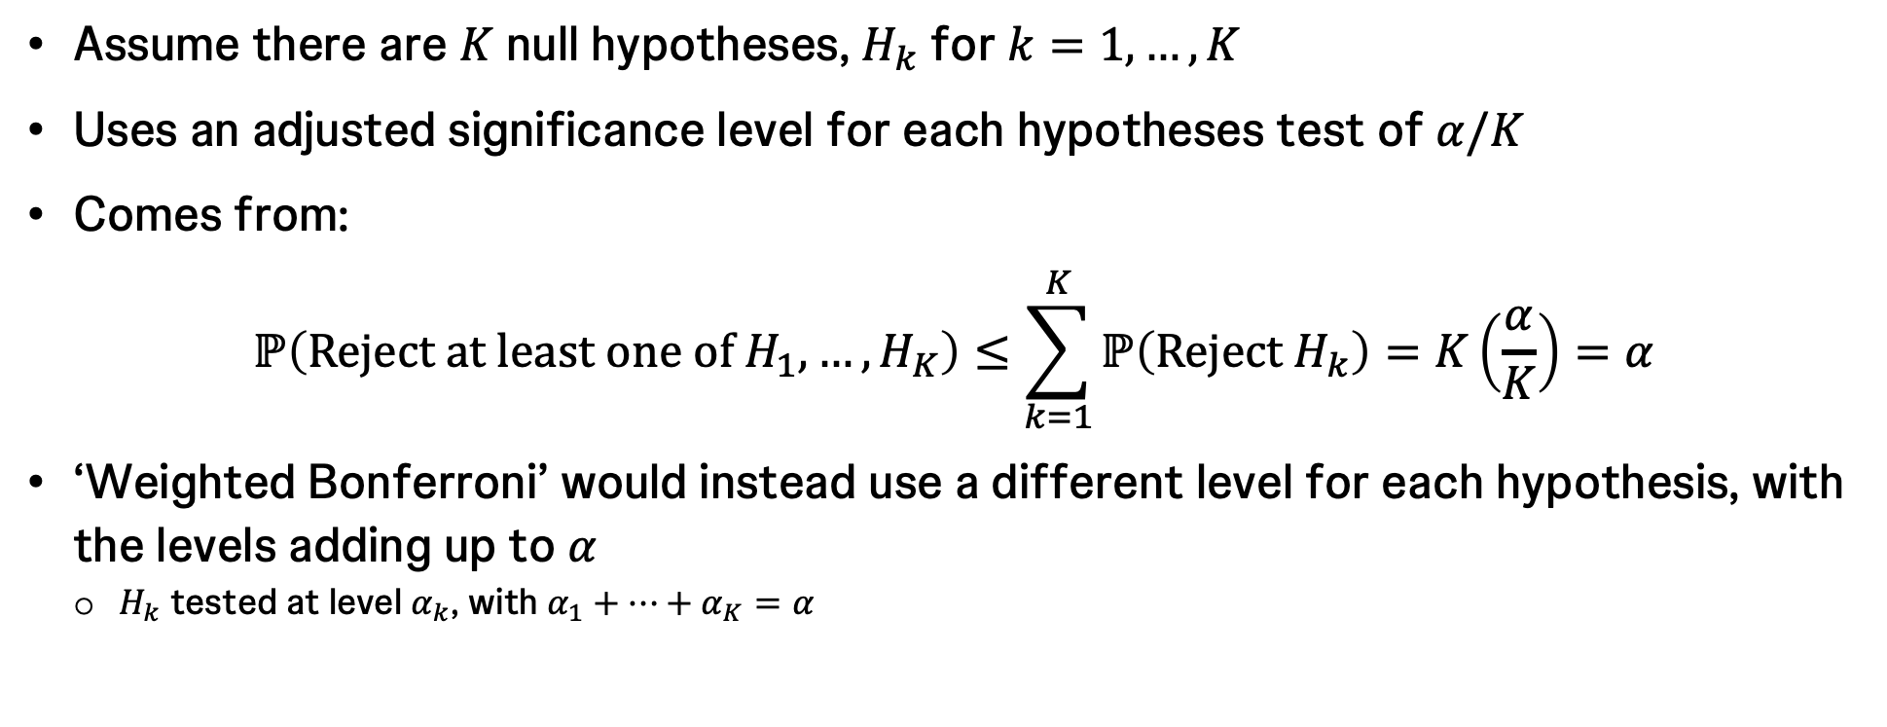
Bonferroni
Assume there are $K$ null hypotheses, $H_{k}$ for $k=1,…,K$
Uses an adjusted significance level for each hypotheses test of $α/K$
Comes from:
$$ℙ\left(Reject at least one of H_{1},…,H_{K}\right)≤\sum_{k=1}^{K}{ℙ\left(Reject H_{k}\right)}=K\left(\frac{α}{K}\right)=α$$
‘Weighted Bonferroni’ would instead use a different level for each hypothesis, with the levels adding up to $α$
$H_{k}$ tested at level $α_{k}$, with $α_{1}+⋯+α_{K}=α$

Slide 49
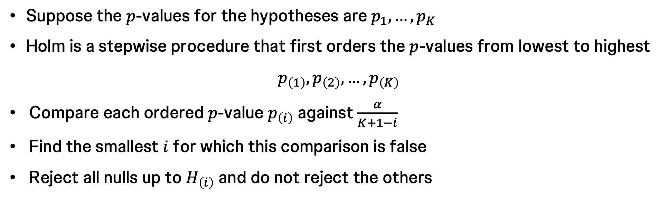
Holm
Suppose the $p$-values for the hypotheses are $p_{1},…,p_{K}$
Holm is a stepwise procedure that first orders the $p$-values from lowest to highest
$$p_{\left(1\right)},p_{\left(2\right)},…,p_{\left(K\right)}$$
Compare each ordered $p$-value $p_{\left(i\right)}$ against $\frac{α}{K+1−i}$
Find the smallest $i$ for which this comparison is false
Reject all nulls up to $H_{\left(i\right)}$ and do not reject the others

Slide 50
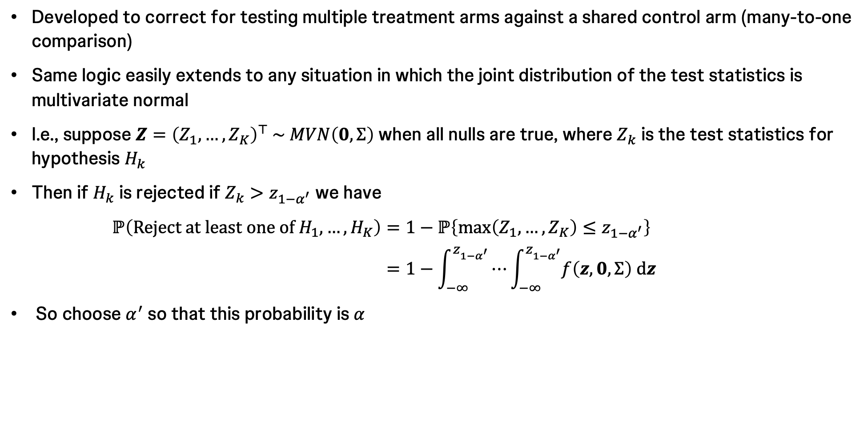
Dunnett
Developed to correct for testing multiple treatment arms against a shared control arm (many-to-one comparison)
Same logic easily extends to any situation in which the joint distribution of the test statistics is multivariate normal
I.e., suppose $Z={\left(Z_{1},…,Z_{K}\right)}^{⊤} \sim MVN\left(0,Σ\right)$ when all nulls are true, where $Z_{k}$ is the test statistics for hypothesis $H_{k}$
Then if $H_{k}$ is rejected if $Z_{k}>z_{1−α^{′}}$ we have
$$ℙ\left(Reject at least one of H_{1},…,H_{K}\right)=1−ℙ\left\{\max\left(Z_{1},…,Z_{K}\right)≤z_{1−α^{′}}\right\}$$
$$=1−\int_{−∞}^{z_{1−α^{′}}}{⋯\int_{−∞}^{z_{1−α^{′}}}{f\left(z,0,Σ\right) dz}}$$
So choose $α^{′}$ so that this probability is $α$

Slide 51
Hierarchical testing procedures
Hypotheses can be ordered following a pre-specified hierarchy before the data are observed
Use clinical/commercial importance, power considerations, maturity time, …
Hierarchical testing procedures test the hypotheses in this order
Fixed sequence procedure
Fallback procedure

Slide 52
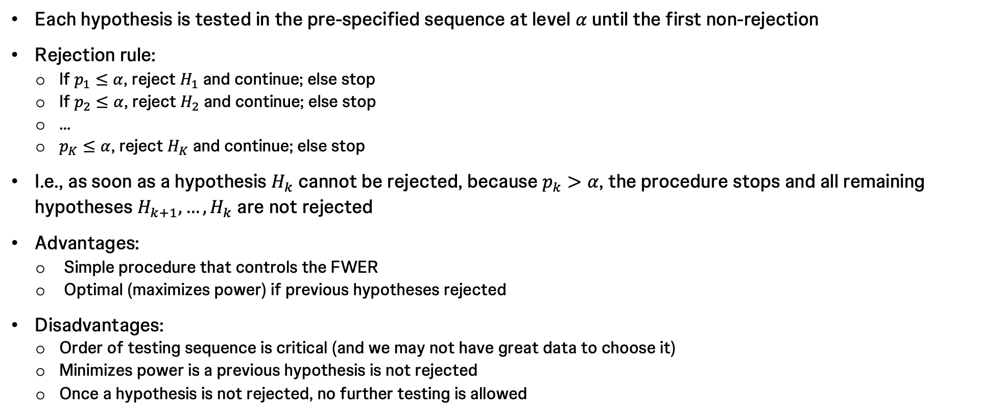
Fixed sequence
Each hypothesis is tested in the pre-specified sequence at level $α$ until the first non-rejection
Rejection rule:
If $p_{1}≤α$, reject $H_{1}$ and continue; else stop
If $p_{2}≤α$, reject $H_{2}$ and continue; else stop
…
$p_{K}≤α$, reject $H_{K}$ and continue; else stop
I.e., as soon as a hypothesis $H_{k}$ cannot be rejected, because $p_{k}>α$, the procedure stops and all remaining hypotheses $H_{k+1},…,H_{k}$ are not rejected
Advantages:
Simple procedure that controls the FWER
Optimal (maximizes power) if previous hypotheses rejected
Disadvantages:
Order of testing sequence is critical (and we may not have great data to choose it)
Minimizes power is a previous hypothesis is not rejected
Once a hypothesis is not rejected, no further testing is allowed

Slide 53
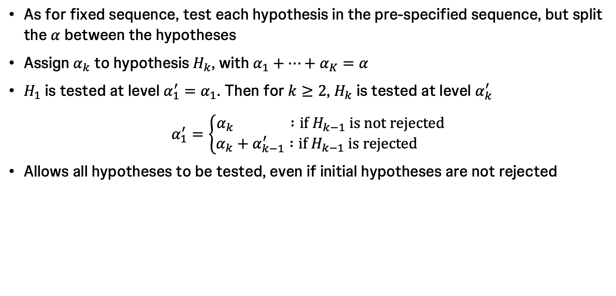
Fallback
As for fixed sequence, test each hypothesis in the pre-specified sequence, but split the $α$ between the hypotheses
Assign $α_{k}$ to hypothesis $H_{k}$, with $α_{1}+⋯+α_{K}=α$
$H_{1}$ is tested at level $α_{1}^{′}=α_{1}$. Then for $k≥2$, $H_{k}$ is tested at level $α_{k}^{′}$
$$α_{1}^{′}=\left\{\begin{aligned}α_{k} :if H_{k−1} is not rejected \\ α_{k}+α_{k−1}^{′} :if H_{k−1} is rejected \end{aligned}\right.$$
Allows all hypotheses to be tested, even if initial hypotheses are not rejected

Slide 54
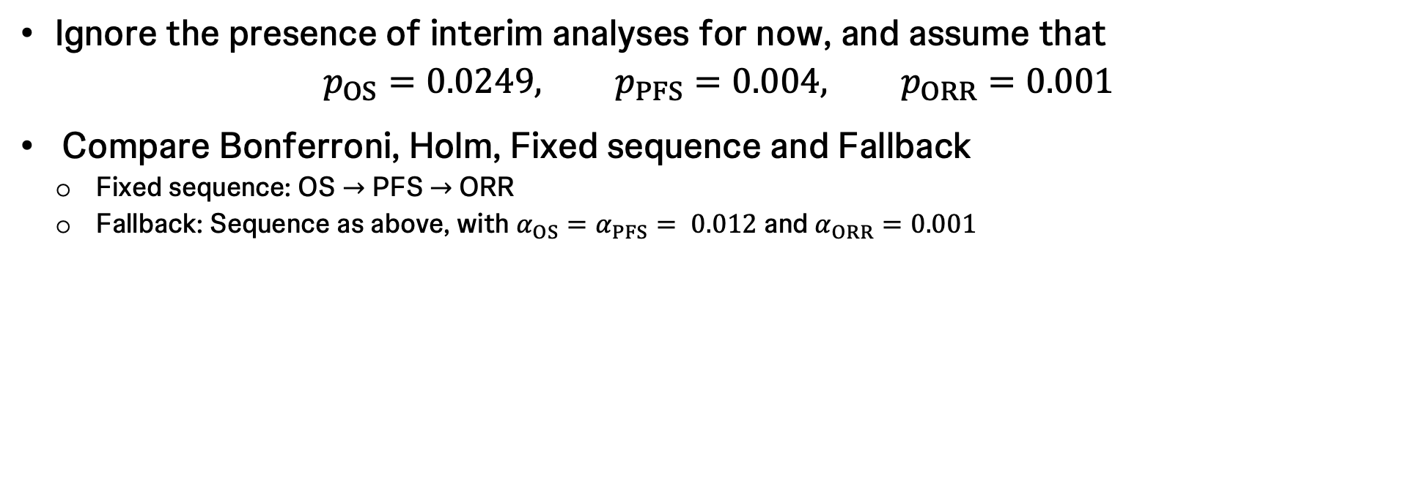
Running example 1: KEYNOTE-598
Ignore the presence of interim analyses for now, and assume that
$$p_{OS}=0.0249, p_{PFS}=0.004, p_{ORR}=0.001$$
Compare Bonferroni, Holm, Fixed sequence and Fallback
Fixed sequence: OS $→$ PFS $→$ORR
Fallback: Sequence as above, with $α_{OS}=α_{PFS}= 0.012$ and $α_{ORR}=0.001$
Hypothesis | Bonferroni | Holm | Fixed sequence | Fallback
OS | Not rejected | Rejected | Not rejected | Not rejected
PFS | Rejected | Rejected | Not rejected | Rejected
ORR | Rejected | Rejected | Not rejected | Rejected

Slide 55
Closed testing procedures
Very general and powerful methodology for constructing multiple testing procedures that strongly control the FWER
Include many well-known procedures as special cases
Relies on construction of tests for intersection hypotheses: see Backup
Main disadvantage: Can be a very large number of intersection hypotheses to test
We focus on a particular shortcut to specifying all intersection hypotheses

Slide 56
Graphical testing procedures (GTPs)
Flexible multiple testing framework that can be tailored to reflect the relative importance of hypotheses
I.e., can deal with complex trial objectives and multiple structured hypotheses
Built on the principle of closed testing
I.e., they can be thought of as a shortcut to specifying a closed testing procedure
Ensures strong FWER control
Very visual technique
Easily and efficiently communicable
Includes many common multiple testing procedures as special cases
Fixed sequence, Bonferroni, Holm, …

Slide 57
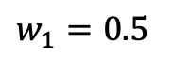
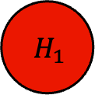
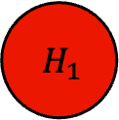
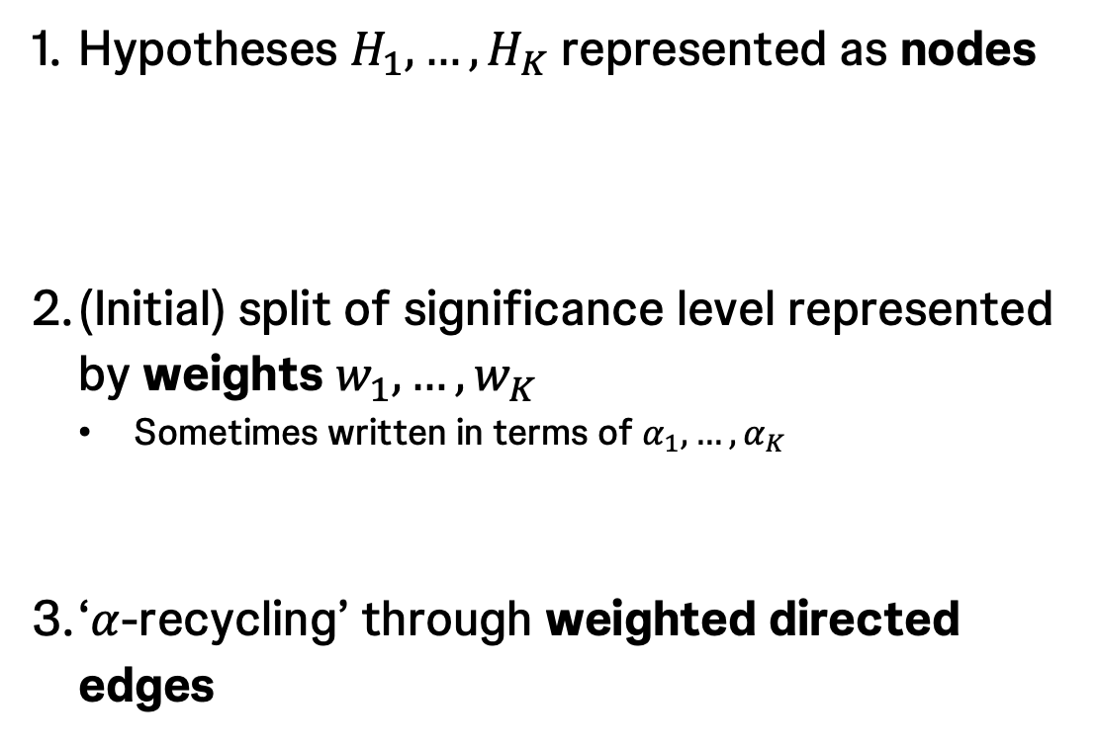
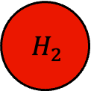
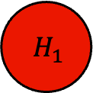
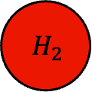
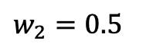
The graph
Specification
Hypotheses $H_{1},…,H_{K}$ represented as nodes
(Initial) split of significance level represented by weights $w_{1},…,w_{K}$
Sometimes written in terms of $α_{1},…,α_{K}$
‘$α$-recycling’ through weighted directed edges
$$H_{1}$$
$$H_{2}$$
$$H_{1}$$
$$H_{2}$$
$$w_{1}=0.5$$
$$w_{2}=0.5$$
1
$$H_{1}$$
$$H_{2}$$
0.5
0.5
1

Slide 58
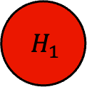
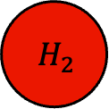
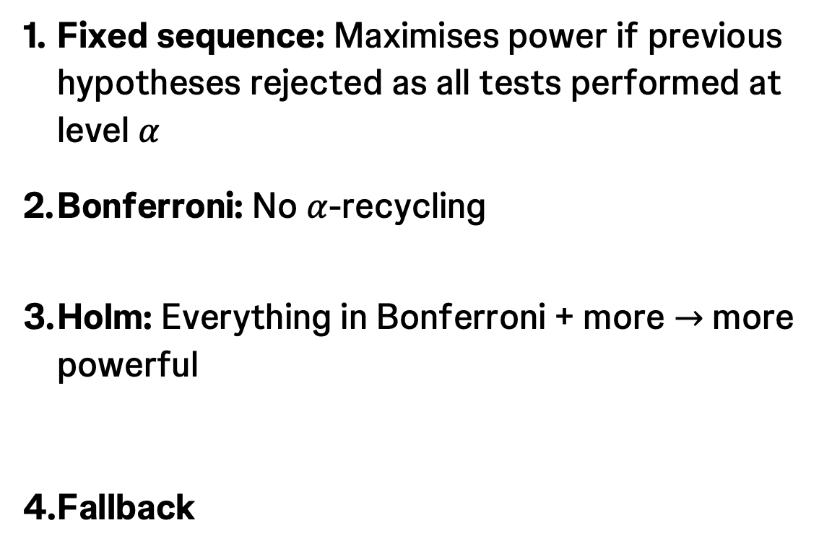
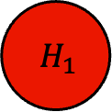
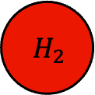
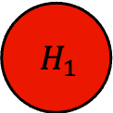
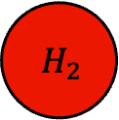
Examples
$$K=2$$
Fixed sequence: Maximises power if previous hypotheses rejected as all tests performed at level $α$
Bonferroni: No $α$-recycling
Holm: Everything in Bonferroni + more $→$ more powerful
Fallback
$$H_{1}$$
$$H_{2}$$
1
0
1
$$H_{1}$$
$$H_{2}$$
0.5
0.5
1
$$H_{1}$$
$$H_{2}$$
0.5
0.5
1
$$H_{1}$$
$$H_{2}$$
w₁
w₂
1

Slide 59
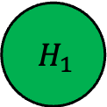
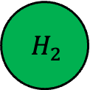
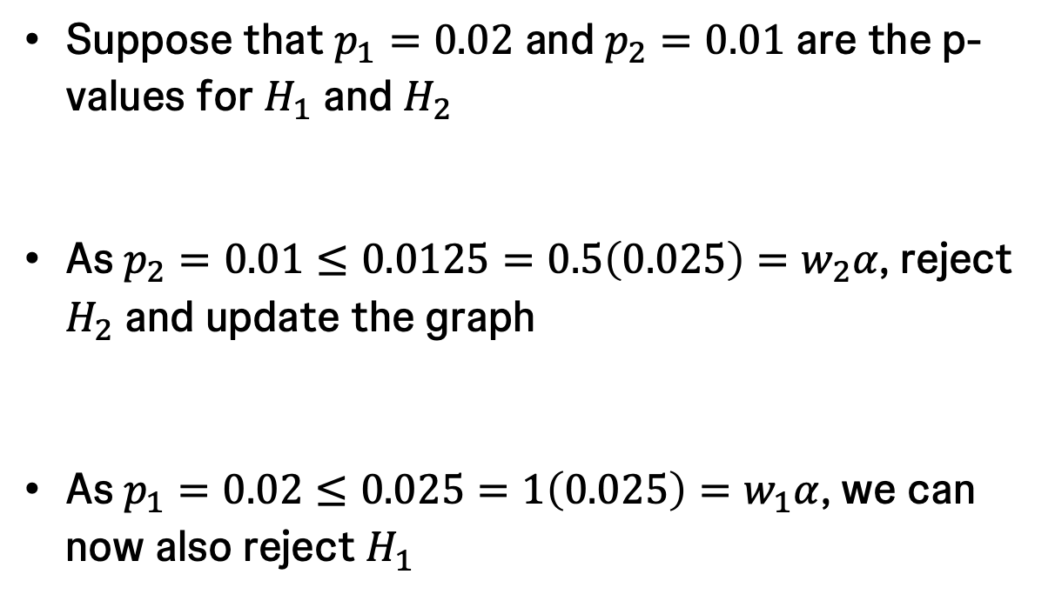
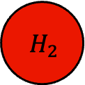
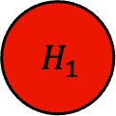
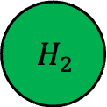
Example: Holm
$K=2$ and $α=0.025$
1
Suppose that $p_{1}=0.02$ and $p_{2}=0.01$ are the p-values for $H_{1}$ and $H_{2}$
As $p_{2}=0.01≤0.0125=0.5\left(0.025\right)=w_{2}α$, reject $H_{2}$ and update the graph
As $p_{1}=0.02≤0.025=1\left(0.025\right)=w_{1}α$, we can now also reject $H_{1}$
$$H_{1}$$
$$H_{2}$$
0.5
0.5
1
$$H_{1}$$
$$H_{2}$$
1
0
$$H_{1}$$
$$H_{2}$$
0
0

Slide 60

Technical basis
The graph defines a closed testing procedure with weighted Bonferroni tests for each intersection hypothesis
If a hypothesis $H_{k}$ can be rejected at level $w_{k}α$ (i.e., $p_{k}≤w_{k}α$), recycle its level $w_{k}α$ to the remaining (not yet tested) hypotheses, according to a prefixed rule, and continue testing with the updated $α$ levels
Can be shown that the order you test in does not matter
I.e., would always end with the same hypotheses being rejected

Slide 61

Technical basis
Graph update algorithm
Transition matrix $G=\left\{g_{ij}\right\}$, where $g_{ij}$ is the fraction of $w_{i}$ allocated to $H_{j}$ if $H_{i}$ is rejected
Require $0≤g_{ij}≤1$, $g_{ii}=0$ and $\sum_{k=1}^{K}{g_{ik}}=1$ for $i,j=1,…,K$
0. Set $𝒦=\left\{1,…,K\right\}$
1. Select a $k∈𝒦$ such that $p_{k}≤w_{k}α$ and reject $H_{k}$; otherwise stop
2. Update the graph:
$𝒦→𝒦\backslash \{k\}$
$w_{l}→\left\{\begin{aligned}w_{l}+w_{k}g_{kl} :l∈𝒦 \\ 0 :otherwise \end{aligned}\right.$
$g_{lm}→\left\{\begin{aligned}\frac{g_{lm}+g_{lk}g_{km}}{1−g_{lk}g_{kl}} :for l,m∈𝒦,l≠m,g_{lk}g_{kl}<1 \\ 0 :otherwise \end{aligned}\right.$
3. If $\left|𝒦\right|≥1$, go to Step 1; otherwise stop

Slide 62

Technical basis
Graph update algorithm

Slide 63


Graphical testing procedure defines intersection hypothesis tests in a closed test
Example
$J$ | $$w_{1}( J)$$ | $$w_{2}( J)$$ | $$w_{3}( J)$$
$H_{1}∩H_{2}∩H_{3}$ | 1/3 | 1/3 | 1/3
$H_{1}∩H_{2}$ | 0.5 | 0.5 | -
$H_{1}∩H_{3}$ | 0.5 | - | 0.5
$H_{2}∩H_{3}$ | 0 | 0.5 | 0.5
$H_{1}$ | 1 | - | -
$H_{2}$ | - | 1 | -
$H_{3}$ | - | - | 1

Slide 64



Consonance
Graphical testing procedure guarantees consonance
Let $p_{k}$ denote an unadjusted observed $p$-value for $H_{k}$
$$J$$ | $$w_{1}( J)$$ | $$w_{2}( J)$$ | $$w_{3}( J)$$ | $${p_{3}<w}_{3}( J)α$$
$H_{1}∩H_{2}∩H_{3}$ | 1/3 | 1/3 | 1/3 | Yes
$H_{1}∩H_{2}$ | 1/2 | 1/2 | -
$H_{1}∩H_{3}$ | 1/2 | - | 1/2 | Yes
$H_{2}∩H_{3}$ | 0 | 1/2 | 1/2 | Yes
$H_{1}$ | 1 | - | -
$H_{2}$ | - | 1 | -
$H_{3}$ | - | - | 1 | Yes
${p_{3}<w}_{3}( J)α$ implies
So can immediately reject $H_{3}$
Consonance is ensured because $w\left(J_{1}\right)≤w(J_{2})$ for $J_{2}⊆J_{1}$

Slide 65



Running example 2
Initial graph
$α$ split initially between the dual primary outcomes
PFS recycles all of its $α$ to OS:
1. to maximise minimal alpha assigned to OS
2. Because less value to short term outcomes after success on PFS
PFS
w = 0.9
ORR w = 0.1
ORR recycles all its $α$ to CR+, because of their similar maturation time
1
1
1
1
OS w = 0
CR w = 0
Include all edges allowed: all four hypotheses have edges totalling 1 leaving them

Slide 66
Running example 2
Sequential updating
Suppose we achieve significance for PFS
PFS
w = 0.9
ORR w = 0.1
1
1
1
1
OS w = 0
CR w = 0

Slide 67
Running example 2
Sequential updating
PFS
w = 0
ORR w = 0.1
1
1
OS w = 0.9
CR w = 0
1
There are now edges that weren’t previously in the graph

Slide 68
Running example 2
Sequential updating
Next suppose we achieve significance for ORR
PFS
w = 0
ORR w = 0
OS w = 0.9
CR w = 0.1
1
1
The graph would look like this regardless of whether PFS was rejected and then ORR, or ORR was rejected and then PFS

Slide 69
Running example 2
Sequential updating
PFS
w = 0
ORR w = 0
Now suppose we achieve significance for CR+
OS w = 0.9
CR w = 0

Slide 70
‘Epsilon’ edges
A form of sequential gatekeeping
Infinitesimally small values on recycling edges can be used to indicate that several hypotheses must be rejected before any alpha is recycled on to some additional set of hypotheses
E.g., modifying the KEYNOTE-598 graph
Suppose CR is also to be tested
ORR and CR only tested after both OS and PFS significance
OS
α = 0.019
PFS α = 0.006
1 - ϵ
1 - ϵ
0.5ϵ
0.5ϵ
0.5ϵ
0.5ϵ
ORR α = 0
CR α = 0
1
1

Slide 71


Partial correlation
Standard GTP makes no assumption of knowledge about the correlation between tests performed for the various hypotheses
If we do wish to use such information, it is relatively straight-forward to do so
E.g., if we know the correlation by design (sub- and overall population tested for the same endpoint)
See Bretz et al. (2011) for further details
Suppose that $K=3$ and we know that $Corr\left(Z_{1},Z_{2}\right)=0.5$. Then Holm’s procedure with and without use of partial correlation is as shown for $α=0.025$
Nothing assumed about other correlations
In practice, power gain from using partial correlation is often small: $α$-recycling is the more important component of the multiplicity strategy

Slide 72
Operating characteristics
Typically, we are most interested in the power for each individual hypothesis at specific levels of alpha availability
E.g., what is the power for PFS when tested at the one-sided 0.02 level?
This is a type of conditional power that doesn’t require multiplicity-specific software for calculation
If we wish to calculate more complex powers, we will need to set an assumption regarding the joint distribution of the test statistics for the various hypotheses
E.g., disjunctive/conjunctive powers across some set of hypotheses
E.g., multiplicity-adjusted power for a specific hypothesis
Assuming they are uncorrelated is often not an awful approach
Simulation is typically the best approach to then calculating these powers
See gMCP::calcPower()

Slide 73
Selecting a GTP
And more generally how to choose a multiplicity correction
In a purely statistical sense, splitting and recycling alpha in more complex way will generally provide a more robust testing procedure
Will see this if you search for an optimal GTP
But can provide little benefit. In practice we typically
Factor in rate at which endpoints mature (e.g., OS last; short-term outcomes first)
Test short-term outcomes (that are often highly correlated) in a hierarchical manner. E.g., ORR and then CR+
Give small amount of alpha to short-term dual primary outcome, so minimal risk to/impact on conventional primary outcome
Recycle some alpha between dual primary outcomes, to increase chance we win on both
Select edges based on trade-offs. I.e., how much does power go up for one hypothesis compared to how much it goes down for another
A lot of publications and regulatory guidance available
E.g., Dmitrienko and D’Agostino (2013); Dmitrienko and D’Agostino (2018); Li et al. (2017); Wang et al. (2011)
EMA: Guideline on multiplicity issues in clinical trials
FDA: Multiple endpoints in clinical trials guidance for industry

Slide 74

Software
R
{gsDesign}: Helps draw, but not evaluate graphs
{gMCP}: Can now be quite challenging to install. Has a GUI
{gMCPLite}: Will install, but no GUI
{graphicalMCP}: New option
Web (R Shiny): GraphApp

Slide 75

GraphApp
https://mrc-bsu.shinyapps.io/20MRC_BSU_GraphApp/

Slide 76

Summary
GTPs are a flexible and powerful method of strongly controlling the FWER across multiple hypotheses
Completely defined by the initial graph, which contains:
Nodes defining hypotheses
Weights defining initial $α$ split
Edges defining how to recycle $α$

Slide 77
4. Break
10 mins

Slide 78
5. Short practical on group-sequential design / graphical testing using R
{gsDesign} and {rpact}
{gMCP}/{gMCPLite} and {graphicalMCP}
30 mins

Slide 79
Practical 1
Recreating the PFS, OS, ORR, and CR designs in Running example 2
See practical1.pdf
As well as practical1_solutions.R and practical1_solutions.pdf
Primary goal is to recreate each of the (group-sequential or fixed sample) designs for the four endpoints included in the multiplicity plan
Then, ignoring the presence of interim analyses, to compute multiplicity-adjusted power
Feel free to use {gsDesign} or {rpact} and {gMCP}/{gMCPLite} or {graphicalMCP} as you prefer
And also the GUI interface to {gsDesign} or {rpact} if preferred
Other exercises also available (e.g., on optimal group-sequential design)
Do ask questions 🙂

Slide 80
6. Graphical testing in group-sequential designs
Combining the graphical and group-sequential methodologies
Analysis triggers
‘Look-back’ analyses
Delayed vs immediate α-recycling
45 mins

Slide 81
History
Long history of methods/applications of GSDs in clinical trials
The same is true for multiplicity corrections such as GTPs
However, the development of methods for correction across multiple hypotheses in a group-sequential setting has primarily occurred over the last 10-15 years
Much of this development was motivated by...

Slide 82

Hierarchical testing of a primary and one secondary endpoint
Hung et al. (2007) considered a two-stage GSD with a primary and one key secondary endpoint
The primary endpoint tested according to some GSD with cumulative one-sided type I error of $α=0.025$
Question: How should we test the secondary endpoint after the primary endpoint achieves significance (either at the IA or FA)?
Investigated naïve strategy for secondary endpoint:
Since the secondary endpoint is tested at most once, when the primary endpoint is significant, it seems reasonable to use the whole $α$ (regardless of IA or FA)

Slide 83

Hierarchical testing of a primary and one secondary endpoint
It was demonstrated that the naive approach does not control the FWER
Depending on the correlation between the endpoints, FWER could be as much as 4.1%
Therefore, specialized methodology is required for FWER control
Naïve strategy
Hung et al. (2007)

Slide 84
GTPs for GSDs
Maurer and Bretz (2013), amongst others, provide highly general methodology for testing primary and secondary endpoints in GSD setting with strong control of the FWER
There are some restrictions assumed in the paper that aren’t necessary; with these relaxed the methodology covers vast majority of trial use cases
Take home message: Essentially, all you have to do is specify your initial GTP and the GSD for each hypothesis
I.e., think of it as the union of two more familiar steps: specifying a GTP and specifying GSDs
There are some finer points, but this gets you most of the way there

Slide 85

“Well ordered” rejection boundaries
Suppose we have a single hypotheses and analyses $j=1,…,J$
Information fraction at analysis $j$ is $t_{j}$, with $t_{1}≤t_{2}≤⋯≤t_{J}=1$
Suppose that the allowed significance level for the hypothesis is $γ$
Let
$f\left(γ,t_{j}\right)$ denote the spending function, with $f\left(γ,1\right)=γ$
$π_{j}\left(γ\right)=f\left(γ,t_{j}\right)−f\left(γ,t_{j−1}\right)$
$p_{j}^{∗}$($γ$) is the corresponding threshold for the nominal $p$-value at analysis $j$
Need a special condition called a ‘well ordered’ boundary:
$p_{j}^{∗}\left(γ\right)≤p_{j}^{∗}\left(γ^{′}\right)$ if $γ≤γ′$ for $j=1,…,J$
For $γ≤γ′$, $π_{j}(γ)≤π_{j}(γ′)$ for all $j⟹p_{j}^{∗}\left(γ\right)≤p_{j}^{∗}\left(γ^{′}\right)$
Another formulation: $f\left(γ,t_{j}\right)≤f\left(γ′,t_{j}\right)$ if $γ≤γ′$ for all $j$ and the second mixed partial derivative of $f\left(.,.\right)≥0$

Slide 86

Defining spending function for each hypothesis
Now, for each hypothesis $k=1,…,K$ consider:
Let $f_{k}\left(α,t\right)$ denote the level-$α$ spending function, $t$is information fraction
$f_{k}\left(α,t\right) m$ust be ‘well-ordered’
Current hypothesis weight in GTP determines $α$ spend for hypothesis $k$, $w_{k}α$
Hence, the current allowed ‘local’ $α$ = $w_{k}α$

Slide 87

Testing algorithm
Start with $j=1$
Test each hypothesis $k$ (not previously rejected at or before) analysis $j$:
Compute the nominal p-value threshold $p_{lk}^{∗}\left(w_{k}α\right)$, $l=1,…,j$, based on $f_{k}\left(w_{k}α,t_{jk}\right)$
Note: $p_{lk}^{∗}\left(w_{k}α\right)$ may change for some $l<j$ , compared to a threshold calculated at previous IAs
If the nominal observed p-value ${p_{lk}≤p}_{lk}^{∗}\left(w_{k}α\right)$ for any $l=1,…,j$, reject hypothesis $k$
If any hypothesis was rejected, relocate $w_{k}$ per GTP and go back to 1, otherwise move to the next analysis

Slide 88

Running example 1: KEYNOTE-598
Initial GTP and GSD for each hypothesis
OS
Two IAs at ~71%IF and ~85%IF
LDOF spending function
Initially it has alpha of 0.019 (weight of 0.76)
PFS
One IA at ~92%IF
LDOF spending function
Initially it has alpha of 0.006 (weight of 0.24)
ORR
No IAs
Initially it has weight of 0
Overall one-sided $α=0.025$
OS
α = 0.019
PFS α = 0.006
0.999
0.999
1
0.001
0.001
ORR α = 0

Slide 89
Running example
To begin with, can only spend α = 0.006 in total
Focus on PFS
OS
α = 0.019
PFS α = 0.006
0.999
0.999
1
0.001
0.001
ORR α = 0

Slide 90
Running example
Focus on PFS
If the graph updates the allowed total spend, the whole spending function updates
OS
α = 0
PFS α = 0.024981
1
1
ORR α = 0.000019

Slide 91
Running example
Focus on PFS
If the graph updates the allowed total spend, the whole spending function updates
OS
α = 0
PFS α = 0.025
ORR α = 0

Slide 92
Running example
To begin with, cannot spend any α
Focus on ORR
OS
α = 0.019
PFS α = 0.006
0.999
0.999
1
0.001
0.001
ORR α = 0

Slide 93
Running example
Significance on either OS or PFS would require very low p-value for significance
Focus on ORR
OS
α = 0.024994
PFS α = 0
1
ORR α = 0.000006
OS
α = 0
PFS α = 0.024981
1
1
ORR α = 0.000019

Slide 94
Running example
Significance on both OS or PFS allows for higher likelihood of ORR success
Focus on ORR
OS
α = 0
PFS α = 0
ORR α = 0.025

Slide 95

‘Look back’ analyses
Significant if w_{PFS} = 1, but not if w_{PFS} = 0.24
The algorithm allows for what has been termed ‘look back’ analyses
E.g., consider PFS in the KEYNOTE-598 example
Suppose that at IA1 we have to stay at $w_{PFS}=0.24$ (because OS wasn’t rejected). Then we aren’t able to reject $H_{PFS}$ based on the black dot in the plot
95

Slide 96

‘Look back’ analyses
Significant if w_{PFS} = 1, but not if w_{PFS} = 0.24
If we reach $w_{PFS}=1$ at PFS’s FA, we are technically allowed to ‘look back’ and claim significance for this hypothesis based on the IA1 result
In practice, this might be a hard sell to regulators as at the FA we have more data available and still have $α$ available for retesting this hypothesis
It usually shouldn’t matter, provided there isn’t a strong trend in the treatment effect
It would only lead to a gain in power if the PFS test statistic is below the orange dot at its FA

Slide 97

‘Look back’ analyses
Where this ‘look back’ is useful is if we have data that matures at different rates
E.g., suppose there’s two hypotheses with expected IFs at three analyses of:
H₁: 50%, 100%, 100%
H₂: 33%, 67%, 100%
Suppose we don’t manage to reject H₁ at IA2, and eventually reject H₂ at the FA
Then we are allowed to retest H₁ using its IA2 p-value with the recycled $α$
This is the case for ORR in Running example 1: KEYNOTE-598

Slide 98

Immediate recycling
The approach for PFS in Running example 1: KEYNOTE-598
This means that the entire spending function trajectory updates when a larger weight becomes available to PFS
Creates an ‘issue’ that some $α$ may be wasted if we only recycle at the FA

Slide 99

Delayed recycling
A way around this $α$ wasting is to prospectively say that additional $α$ will only be used at the FA if more weight becomes available
Can think of this like changing the spending function
vs. immediate recycling which keeps the same spending function, but just updates how much can be spent

Slide 100
Immediate vs. delayed recycling
Which is best?
Usually, immediate recycling will be the preferred approach
Corresponds to the usual reason for doing a GSD: trying to increase the chance of an earlier significant result
Delayed recycling does the opposite: by pushing spend later in the trial it increases power, at the cost of expecting significance to occur later
Delayed recycling may make more sense for outcomes around which there is more uncertainty about the effect or for which an early significant result is unlikely
It’s also possible to define recycling to begin at a certain analysis
E.g., recycling from analysis 3 in a trial with up to 5 analyses
But you cannot choose the time from which you recycle adaptively: it has to be prespecified

Slide 101
Changing the spending function
What and why?
Could alternatively think of delayed recycling as a particular case of changing the spending function after recycling
Changing it to delay recycling as much as possible
May change the spending function to recycle more alpha earlier
Recall what we said earlier about the ‘well ordered’ boundary requirement: this needs to be checked!
Makes sense when after success on one hypothesis, the value of another diminishes over time
E.g. 1, three-arm design where need significance on both experimental arms at some time
E.g. 2, short term outcome value reduced after success on conventional endpoint
E.g., PFS switching from LDOF to KDM(1) in Running example 1: KEYNOTE-598

Slide 102
Recipe book for fully specifying an interim analysis and multiplicity plan
Five components: Hypotheses, analyses, enrollment information, distributional assumptions, GTP
Enrollment information: Speed and duration of enrollment over time to each of the treatment arms, by sub-population if needed
Hypotheses: Define each hypothesis included in the GTP precisely
What treatments are compared?
In what sub-populations?
For which endpoint?
At what analyses?
Using what spending function(s)?
Analyses: Specify what triggers each of the analyses
Is an endpoint used (e.g., PFS) or is it calendar-based?
How many events / what sample size is required? With what follow up? In what sub-population(s) and for what treatment arms?
Distributional information: For all hypotheses, need to assume effect sizes to evaluate power
Graphical testing procedure: The initial graph uniquely defines the plan for sharing alpha across hypotheses

Slide 103
Running example 1: KEYNOTE-598
Five components: Hypotheses, analyses, enrollment information, distributional assumptions, GTP
Enrollment information: 568 pts, randomized 1:1 over 20 mo
Hypotheses:
OS: Analysed at all 3 analyses, using LDOF spending function with immediate recycling
PFS: Analyses at the first 2 analyses, using LDOF spending function with immediate recycling
ORR: Matures at the first analysis
Analyses:
IA1. 255 OS events
IA2. 307 OS events
FA. 361 OS events
Distributional information:
OS: Exponential with a median of 20 mo. HR = 0.7. 1% yearly drop-out
PFS: Piece-wise exponential with a median of 6.5 mo before 6.5 mo and a median of 14.5 mo after 6.5 mo. HR = 0.69. 13% yearly drop-out
ORR: 59% vs 39%
Graphical testing procedure: See earlier

Slide 104
Running example 1: KEYNOTE-598
Example implementation in practice: IA1
Accrued events / sample size for each hypothesis
Analysis | OS | PFS | ORR
IA1 | 255 | 356 | 568
IA2
FA
Test statistic for each hypothesis
Analysis | OS | PFS | ORR
IA1 | 0.016 | 0.006 | 0.009
IA2
FA
Current efficacy boundaries (p-value scale)
Current graphical testing procedure
OS
α = 0.019
PFS α = 0.006
0.999
0.999
1
0.001
0.001
ORR α = 0

Slide 105
Running example 1: KEYNOTE-598
Example implementation in practice: IA2
Accrued events / sample size for each hypothesis
Analysis | OS | PFS | ORR
IA1 | 255 | 356 | 568
IA2 | 307 | 388 | -
FA
Test statistic for each hypothesis
Analysis | OS | PFS | ORR
IA1 | 0.016 | 0.006 | 0.009
IA2 | 0.014 | 0.003 | -
FA
Current efficacy boundaries (p-value scale)
Current graphical testing procedure
OS
α = 0.019
PFS α = 0.006
0.999
0.999
1
0.001
0.001
ORR α = 0

Slide 106
Running example 1: KEYNOTE-598
Example implementation in practice: PFS is rejected and the graph updates, which triggers updating the efficacy boundaries
Accrued events / sample size for each hypothesis
Analysis | OS | PFS | ORR
IA1 | 255 | 356 | 568
IA2 | 307 | 388 | -
FA
Test statistic for each hypothesis
Analysis | OS | PFS | ORR
IA1 | 0.016 | 0.006 | 0.009
IA2 | 0.014 | 0.003 | -
FA
Current efficacy boundaries (p-value scale)
Current graphical testing procedure
OS
α = 0.024994
PFS α = 0
1
ORR α = 0.000006

Slide 107
Running example 1: KEYNOTE-598
Example implementation in practice: FA
Accrued events / sample size for each hypothesis
Analysis | OS | PFS | ORR
IA1 | 255 | 356 | 568
IA2 | 307 | 388 | -
FA | 361 | - | -
Test statistic for each hypothesis
Analysis | OS | PFS | ORR
IA1 | 0.016 | 0.006 | 0.009
IA2 | 0.014 | 0.003 | -
FA | 0.011 | - | -
Current efficacy boundaries (p-value scale)
Current graphical testing procedure
OS
α = 0.024994
PFS α = 0
1
ORR α = 0.000006

Slide 108
Running example 1: KEYNOTE-598
Example implementation in practice: OS is rejected and the graph update , which triggers updating the efficacy boundaries
Accrued events / sample size for each hypothesis
Analysis | OS | PFS | ORR
IA1 | 255 | 356 | 568
IA2 | 307 | 388 | -
FA | 361 | - | -
Test statistic for each hypothesis
Analysis | OS | PFS | ORR
IA1 | 0.016 | 0.006 | 0.009
IA2 | 0.014 | 0.003 | -
FA | 0.011 | - | -
Current efficacy boundaries (p-value scale)
Current graphical testing procedure
OS
α = 0
PFS α = 0
ORR α = 0.025

Slide 109
Running example 1: KEYNOTE-598
Example implementation in practice: ORR is rejected
Accrued events / sample size for each hypothesis
Analysis | OS | PFS | ORR
IA1 | 255 | 356 | 568
IA2 | 307 | 388 | -
FA | 361 | - | -
Test statistic for each hypothesis
Analysis | OS | PFS | ORR
IA1 | 0.016 | 0.006 | 0.009
IA2 | 0.014 | 0.003 | -
FA | 0.011 | - | -
Current efficacy boundaries (p-value scale)
Current graphical testing procedure
OS
α = 0
PFS α = 0
ORR α = 0

Slide 110
Selecting an interim analysis and multiplicity plan
General considerations
Advantageous to trigger early analyses based on maturation of data for short-term outcome(s)
Typically subject to less uncertainty around timing; characterizing this uncertainty can be helpful
Subsequent analysis often then the earliest point HAs will accept for the conventional primary outcome
Select carefully analysis triggers reflecting on expectation in calendar time
Regulatory authorities may ask for number of events specifications rather than calendar times
Wrong assumptions might substantially deviate calendar timing of IAs
It is always easier to remove analyses, rather than add them.
Keep in mind the required delta for significance on the short-term outcome when selecting its initial alpha
Regulatory authorities may ask for OS to be powered for the lowest amount of alpha it can be tested with

Slide 111

Summary
GTPs can easily be incorporated in a GSD framework
Specify at a minimum
Initial graph
Spending function and IFs for each hypothesis
Preferably specify the five components: Hypotheses, analyses, enrollment information, distributional information, initial graph
Tip: decouple the graph and the spending in your mind
The graph only tells you how much $α$, in total, you have to spend on a hypothesis. It tells you nothing about how it will be spent
I.e., the process involves specifying what you would for a GTP in a fixed-sample trial and what you would for each hypothesis in a GSD

Slide 112
7. Break
10 mins

Slide 113
8. Software demonstration and practical
Describing the method in a Protocol/SAP
R Markdown for automated interim analysis and multiplicity strategy appendix generation
45 mins

Slide 114

Simple graphs
Easy to determine all $α$ levels each hypothesis may be tested at
Feed each one into your favourite GSD software to determine all possible stopping rules for that hypothesis
Assuming the test statistics for the hypotheses are uncorrelated, can even compute power fairly easily
Describing in the protocol/SAP is also relatively easy as there’s not much to describe
$→$ Business as usual

Slide 115

More complex graphs
If you determine all possible $α$ levels a given hypothesis can be tested at, can do as for a simple graph
But becomes much more labor intensive / more challenging as graph complexity increases
Tools for automation become more helpful…
Becomes logical to have a dedicated protocol/SAP Appendix on the multiplicity strategy
{gMCPLite} article dicusses how to produce tables like the ones shown earlier for Running example 1: KEYNOTE-598
https://merck.github.io/gMCPLite/articles/GraphicalMultiplicity.html
See Keaven Anderson’s talk in Session PSW8 on Wednesday afternoon
We will use some R Markdown wrapped code in {appendMCP}

Slide 116
What to include?
We’ve taken a systematic approach and searched for available examples of where a GTP has been used in a GSD framework
~45 or so examples with published protocols/SAPs available
Often redacted in parts, but still useful
Determined what has been included in these examples, and built the output from our code around this
ADAURA | CEPHEUS | ENDEAVOR | IMpower132 | KEYNOTE-048 | KEYNOTE-355 | KEYNOTE-598 | KEYNOTE-689 | PERSEUS
ANDROMEDA | CHANGE AFIB | ESSENCE | IMpower133 | KEYNOTE-091 | KEYNOTE-361 | KEYNOTE-604 | KEYNOTE-716 | PROpel
ANNOUNCE | CLARION | EVOKE-01 | IND227 | KEYNOTE-183 | KEYNOTE-394 | KEYNOTE-641 | KEYNOTE-826 | TROPiCS-02
AtTEnd | CLEAR | HER2CLIMB | innovaTV 301 | KEYNOTE-204 | KEYNOTE-522 | KEYNOTE-671 | KEYNOTE-A18 | VERTIS CV
ATTRACTION-4 | EMBER-3 | IMforte | KEYLYNK-010 | KEYNOTE-240 | KEYNOTE-564 | KEYNOTE-671 | NRG-GY018 | VITALITY-HFpEF

Slide 117

Running example 1: KEYNOTE-598
Input: Stay in the input code block
Should only ever need to modify code here
$$⋮$$
$$⋮$$
$$⋮$$

Slide 118

Running example 1: KEYNOTE-598
Input: Options to tweak outputting
Helpful approach if the multiplicity plan may be subject to revision

Slide 119

Running example 1: KEYNOTE-598
Input: Enrollment information

Slide 120

Running example 1: KEYNOTE-598
Input: Basic hypothesis data, GTP weights, and spending functions
Basic information about the hypotheses
Spending function for each hypothesis
Weights in GTP

Slide 121

Running example 1: KEYNOTE-598
Input: When are the hypotheses analysed and when do the analysed end
OS is analyzed three times, at specified IFs
PFS is analysed twice, and ORR once, based on the OS maturity
OS has a final information level; the others can be inferred

Slide 122

Running example 1: KEYNOTE-598
Input: Distributional information
Exponential distributions for the two arms and the dropout hazard
The class defines the type of endpoint
PWE distributions for the two arms and the dropout hazard
39% vs 59%, assuming it takes 6 mo for the ORR data to ‘mature’

Slide 123

Running example 1: KEYNOTE-598
Input: Further enrollment information
If the hypothesis is in a sub-population, specify its prevalence

Slide 124

Running example 1: KEYNOTE-598
Input: Parameterized GTP
OS
α = 0.019
PFS α = 0.006
s
s
1
1 - s
1 - s
ORR α = 0

Slide 125

Running example 1: KEYNOTE-598
Output: High level summary of hypotheses, their assumptions, and testing strategy

Slide 126

Running example 1: KEYNOTE-598
Output: When the analyses are expected by hypothesis
OS
PFS
ORR

Slide 127

Running example 1: KEYNOTE-598
Output: What hypotheses are analysed by each analysis
IA1
IA2
FA

Slide 128

Running example 1: KEYNOTE-598
Output: Data accrual

Slide 129


Running example 1: KEYNOTE-598
Output: Requirements for specific $α$ levels for each hypothesis
As hypotheses are rejected, the $α$ for OS increased

Slide 130



Running example 1: KEYNOTE-598
Output: Cumulative powers and significance thresholds for each hypothesis for each $α$ level
90% power initially for OS
Initial $α$
OS
After PFS significance
After PFS and ORR significance
$α$ splitting does not cost OS much

Slide 131
Summary
You can easily use standard software for computing the stopping rules under a simple graph
For more complex graphs, if you need all the possible stopping rules then using automation can expedite things substantially
Support in {appendMCP} extensive and growing
E.g., allows ‘nominal’ spends at early IAs
Don’t reinvent the wheel: multiplicity appendix provides a way to clearly explain the plan to regulatory authorities
For all graphs, certain ‘conditional powers’ are easy to get: if you need unconditional powers, you likely need simulation

Slide 132
Practical 2
Recreating the complete interim analysis and multiplicity plan for Running example 2
See practical2.pdf
As well as practical2_solutions.R and practical2_solutions.pdf
The objective is to recreate the full interim analysis and multiplicity plan for Running example 2
Start with the template for Running example 1 and convert as needed
As before, do ask questions 🙂

Slide 133
9. Q&A and Close
10 mins

Slide 134

Summary
Approaches to testing multiple hypotheses in a GSD framework that may seem reasonable can inflate the FWER
Specialist methodology is therefore required: GTPs are such an approach, that can be readily used in a GSD setting
We must specify:
The initial graph
The GSD for each of the hypotheses in the graph
(And the approach to using recycled $α$; immediate vs delayed)

Slide 135
Extensions
GTPs (typically) do not make use of correlation between test statistics
Generally speaking we can’t use estimates of unknown correlations / it often isn’t a great idea to pre-specify guesses for unknown correlations
E.g., the correlation between endpoints like PFS and OS
But using known correlations can make things more efficient
E.g., the correlation induced by a shared control arm in a multi-arm trial
There are extensions to what’s been discussed to use such correlations
In fact, if we need a very general testing approach, any closed testing procedure can be incorporated into a GSD framework
Tang and Geller

Slide 136
Feedback and contact information
Any and all feedback on how to improve the course in the future would be very gratefully received!
Any issues / questions / etc. please do reach out
mgraylin@its.jnj.com
ytymofye@its.jnj.com

Slide 137
Thank you for listening! Any questions?

Slide 138
References
Closed testing procedures / Graphical testing procedures in fixed-sample designs
Bretz F, Maurer W, Brannath W, Posch M (2009) A graphical approach to sequentially rejective multiple test procedures. Stat Med 28:586-604
Marcus R, Peritz E, Gabriel KR (1976) On closed testing procedures with special reference to ordered analysis of variance. Biometrika 63:655-60
Group-sequential design
Hwang IK, Shih WJ, DeCani JS (1990) Group sequential designs using a family of type I error proability spending functions. Stat Med 9:1439-45
Jennison C, Turnbull BW (2000) Group sequential methods with applications to clinical trials. Chapman & Hall: Boca Raton, FL
Kim K, DeMets DL (1987) Design and analysis of group sequential tests based on the type I error spending rate function. Biometrika 74:149-54
Lan KKG, DeMets DL (1983) Discrete sequential boundaries for clinical trials. Biometrika 70:659-63
O’Brien PC, Fleming TR (1979) A multiple testing procedure for clinical trials. Biometrics 35:549-56
Pocock SJ (1977) Group sequential methods in the design and analysis of clinical trials. Biometrika 64:191-99
Wang SK, Tsiatis AA (1987) Approximately optimal one-parameter boundaries for group sequential trials. Biometrics 43:193-200
Multiple testing procedures for GSDs
De S, Baron M (2012) Step-up and step-down methods for testing multiple hypotheses in sequential experiments. J Stat Plan Infer 142:2059-70
Fu Y (2018) Step-down parametric procedures for testing correlated endpoints in a group-sequential trial. Stat Biopharm Res 10:18-25
Glimm E, Maurer W, Bretz F (2010) Hierarchical testing of multiple endpoints in group-sequential trials. Stat Med 29:219-28
Gou J (2020) Sample size optimization and initial allocation of the significance levels in group sequential trials with multiple endpoints. Biom J 64:301-11
Hung H, Wang S, O’Neill R (2007) Statistical considerations for testing multiple endpoints in group sequential or adaptive clinical trials. J Biopharm Stat 17:1201-10
Kosorok M, Yuanjun S, DeMets D (2004) Design and analysis of group sequential clinical trials with multiple primary endpoints. Biometrics 60:134-45
Li H, Wang J, Luo X, Grechko J, Jennison C (2018) Improved two-stage group sequential procedures for testing a secondary endpoint after the primary endpoint achieves significance. Biom J 60:893-902
Li X, Wulfsohn M, Koch G (2017) Considerations on testing secondary endpoints in group sequential design. Stat Biopharm Res 9:333-7
Maurer W, Bretz F (2013) Multiple testing in group sequential trials using graphical approaches. Stat Biopharm Res 5:311-20
Maurer W, Glimm E, Bretz F (2011) Multiple and repeated testing of primary, coprimary, and secondary hypotheses. Stat Biopharm Res 3:336-52
Ohrn F, Niewczas J, Burman CF (2021) Improved group sequential Holm procedures for testing multiple correlated hypotheses over time. J Biopharm Stat 32:230-46
Proschan M, Follmann D (2022) A note on familywise error rate for a primary and secondary endpoint. Biometrics
Tamhane A, Gou J, Jennison C, Mehta C, Curto T (2018) A gatekeeping procedure to test a primary and a secondary endpoint in a group sequential design with multiple interim looks. Biometrics 74:40-8
Tamhane A, Mehta C, Liu L (2010) Testing a primary and a secondary endpoint in a group sequential design. Biometrics 66:1174-84
Tamhane A, Xi D, Gou J (2021) Group sequential Holm and Hochberg procedures. Stat Med 40:5333-50
Tang D, Gnecco C, Geller N (1989) Design of group sequential clinical trials with multiple endpoints. J Am Stat Assoc 84:775-9
Xi D, Tamhane A (2015) Allocating recycled significance levels in group sequential procedures for multiple endpoints. Biom J 57:90-107
Ye Y, Li A, Liu L, Yao B (2013) A group sequential Holm procedure with multiple primary endpoints. Stat Med 32:1112-24
Misc.
Kunzmann K, Pilz M, Herrmann C, Rauch G, Kieser M (2021) The adoptr package: Adaptive optimal designs for clinical trials in R. J Stat Soft 98:1-21
Pilz M, Kunzmann K, Herrmann C, Rauch G, Kieser M (2021) Optimal planning of adaptive two-stage designs. Stat Med 40:3196-213

Slide 139
10. Backup
Closed testing procedures

Slide 140

Closed testing procedures
General methodology to construct multiple testing procedures that strongly control the FWER (Marcus et al, 1976)
Closed testing procedures consider all intersection hypotheses
$$H_{𝒦}=\bigcap_{k∈𝒦}{H_{k}}, 𝒦⊆\left\{1,…,K\right\}$$
Closure principle: An individual hypothesis $H_{k}$ is rejected at familywise level $α$ only if every intersection hypothesis $H_{𝒦}$ with $k∈𝒦$ is rejected at local level $α$
Reject $H_{i}$ $⟺$ all $H_{J} : i ∈J$ are rejected
Example ($K=3$): To reject $H_{1}$ (while controlling FWER at level $α$) need to reject all intersection hypotheses $H_{1}$, $H_{1}∩H_{2}$, $H_{1}∩H_{3}$, $H_{1}∩H_{2}∩H_{3}$ (by $α$-level tests)

Slide 141

Closed testing procedures
Advantages:
Includes many well-known procedures as special cases
Closed test procedures are more powerful than the procedures they are derived from
By construction, they are coherent: if null $H_{I}$ is rejected, all subsets $H_{J}⊆H_{I} are rejected as well$
Any non-coherent multiple testing procedure can be replaced by a coherent one that is at least as powerful
Any coherent multiple test controlling FWER is a closed test
Disadvantages:
No natural point estimates or confidence intervals
Can be a very large number of intersection hypotheses to test as $K$ increases: worst-case is $2^{K}−1$

Slide 142




Closure principle
Venn diagram for $K=2$
Test $H_{\left\{1,2\right\}}$ using Bonferroni or Dunnett etc. at level $α$
Test $H_{1}$ and $H_{2}$ using a level $α$ test
$$H_{1}$$
$$H_{\left\{1,2\right\}}$$
$$H_{2}$$

Slide 143




Closure principle
$K=2$
Reject $H_{1}$ overall if $H_{\left\{1,2\right\}}$ and $H_{1}$ are rejected locally at level $α$
If $K>2$, several intersection hypotheses have to be tested
Different tests can be chosen for each intersection hypothesis
$$H_{\left\{1,2\right\}}=H_{1}∩H_{2}$$
$$H_{1}$$
$$H_{2}$$

Slide 144




Closure principle
Holm for $K=2$
Holm’s procedure is the closure principle applied to Bonferroni
$H_{\left\{1,2\right\}}$ is rejected if either $p_{1}≤α/2$ or $p_{2}≤α/2$
$$p_{1}≤α/2 \text{or} p_{2}≤α/2$$
$$p_{1}≤α$$
$$p_{2}≤α$$

Slide 145


Closure principle
Fixed sequence for $K=2$
With a priori fixed order $H_{1}→H_{2}$
$$p_{1}≤α$$
$$p_{1}≤α$$
$$p_{2}≤α$$

Slide 146



Closure principle
Fallback procedure for $K=2$
With a priori fixed order $H_{1}→H_{2}$ and alpha $α_{k}$ assigned to $H_{k}$
$p_{1}≤α_{1}$ or $p_{2}≤α_{2}$
$$p_{1}≤α_{1}$$
$$p_{2}≤α$$

Slide 147







Closure principle
Holm for $K=3$
$$H_{\left\{1,2,3\right\}}=H_{1}∩H_{2}∩H_{3}$$
$p_{1}≤α/3$ or $p_{2}≤α/3$ or $p_{3}≤α/3$
$$H_{\left\{1,2\right\}}=H_{1}∩H_{2}$$
$p_{1}≤α/2$ or $p_{2}≤α/2$
$$H_{\left\{1,3\right\}}=H_{1}∩H_{3}$$
$p_{1}≤α/2$ or $p_{3}≤α/2$
$$H_{\left\{2,3\right\}}=H_{2}∩H_{3}$$
$p_{2}≤α/2$ or $p_{3}≤α/2$
$$H_{1}$$
$$p_{1}≤α$$
$$H_{2}$$
$$p_{2}≤α$$
$$H_{3}$$
$$p_{3}≤α$$

Slide 148





Closure principle
Fixed sequence for $K=3$
With a priori fixed order $H_{1}→H_{2}→H_{3}$
$$H_{\left\{1,2,3\right\}}=H_{1}∩H_{2}∩H_{3}$$
$$p_{1}≤α$$
$$H_{\left\{1,2\right\}}=H_{1}∩H_{2}$$
$$p_{1}≤α$$
$$H_{\left\{1,3\right\}}=H_{1}∩H_{3}$$
$$p_{1}≤α$$
$$H_{\left\{2,3\right\}}=H_{2}∩H_{3}$$
$$p_{2}≤α$$
$$H_{1}$$
$$p_{1}≤α$$
$$H_{2}$$
$$p_{2}≤α$$
$$H_{3}$$
$$p_{3}≤α$$

Slide 149

Graphical testing procedures
As a short-cut to a closed testing procedure
In general, a CTP requires on the order of $2^{K}$ tests to be done
“Shortcut” (no need to check all tests) if using Bonferroni test for $H_{J}=∩_{j∈J}H_{j}$
Reject $H_{J}$ if for at least one $k∈J$ ${p_{k}<w}_{k}( J)α$
Monotonicity condition holds:
$w_{k}\left(J\right)<w_{k}\left(U\right) ∀k$ when $U⊆J$, $k∈J$
If $p$-value for $H_{k}$for small enough to reject global intersection test, the corresponding individual $H_{k}$ is guaranteed rejection (consonance)
CTP reduced to the order $K$ tests
Each successful rejection removes one hypothesis from the set

Slide 150

Non-consonance
Example
The Simes test (Simes, 1986)
Consider ordered unadjusted $p$-values $p_{(1)}≤…≤p_{(K)}$
Reject $H_{I}$ if there is $k$ such that $p_{(k)}≤\frac{k}{m}α$
Example ($K=3$): As in Hommel (2007)
Equal weights, i.e., $w_{\left(i\right)}\left(I\right)=\frac{1}{\left|I\right|}$. Using $α=0.05$
$p_{1}=p_{2}=0.03$, $p_{3}=0.07$
Can reject the global null $H_{1}∩H_{2}∩H_{3}$ using the Simes test because
$p_{(2)}≤\frac{2}{3}0.0$5
Can not reject neither $H_{1}∩H_{3}$ nor $H_{2}∩H_{3}$, hence no rejection of individual $H_{k}$
Using weights, e.g., defined by graphical approach, applying the Simes test for interception hypotheses will result in more powerful procedure, but no “shortcut”. See Bretz et al. (2011)

